Slide 1
ELEMENTARY COMBINATORICS & PROBABILITY
Lecture 8
Conditional probability, Bayes’ rule

Slide 2
Last time
Probability of an event
Frequentist interpretation of probability (Python)

Slide 3
TODAY
Conditional probability
The law of total probability
Bayes’ rule

Slide 4
Warm-up

Slide 5
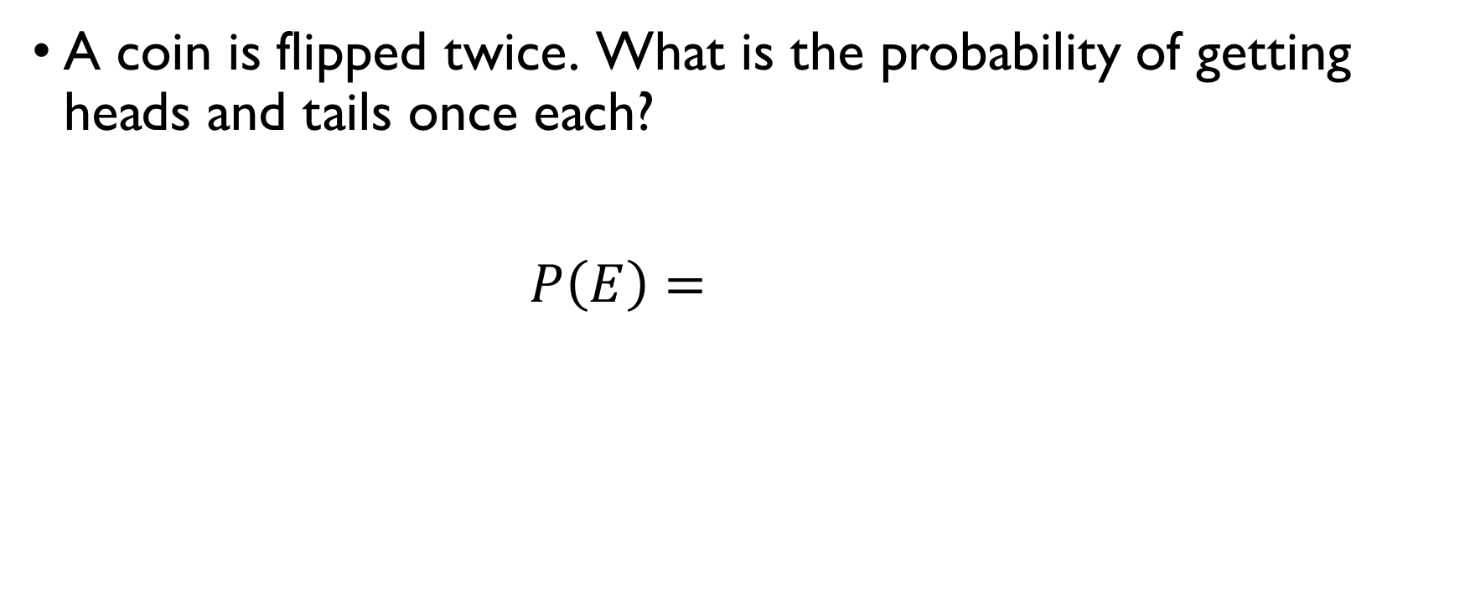
Two coin flips
A coin is flipped twice. What is the probability of getting heads and tails once each?
$$P\left(E\right)=\frac{1+1}{2^{2}}=\frac{1}{2}$$

Slide 6
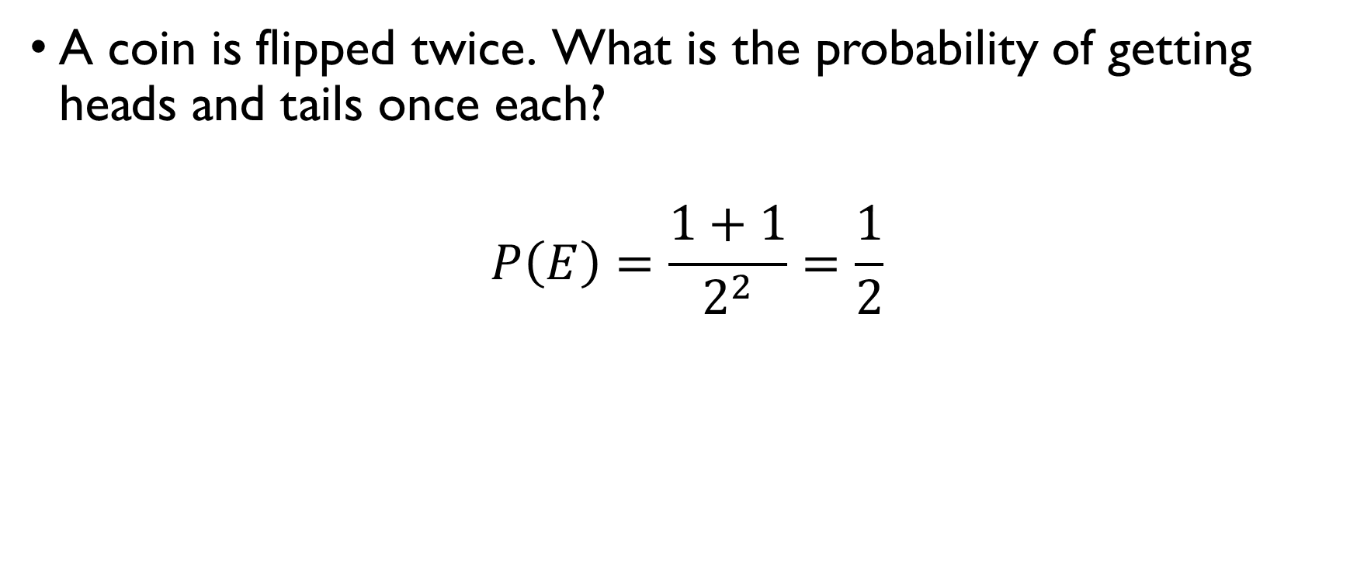
Two coin flips
A coin is flipped twice. What is the probability of getting heads and tails once each?
$$P\left(E\right)=\frac{1+1}{2^{2}}=\frac{1}{2}$$

Slide 7
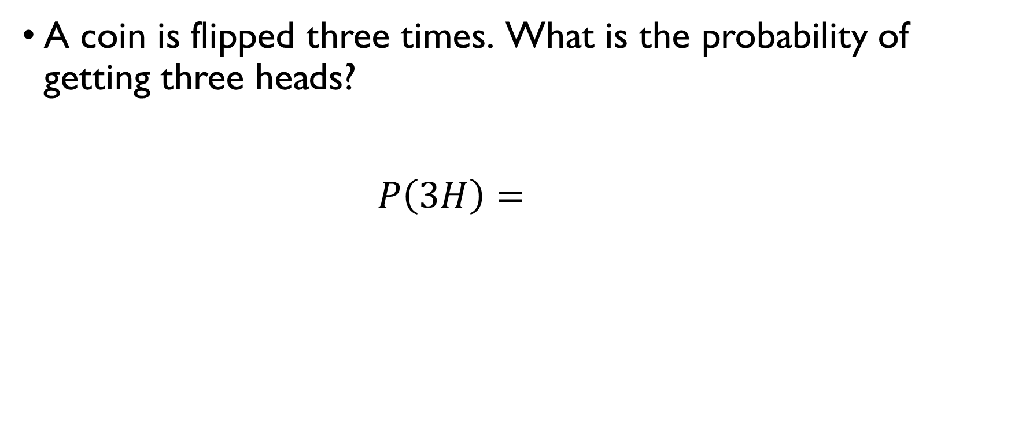
three coin flips
A coin is flipped three times. What is the probability of getting three heads?
$$P\left(3H\right)=\frac{1}{2^{3}}=\frac{1}{8}$$

Slide 8
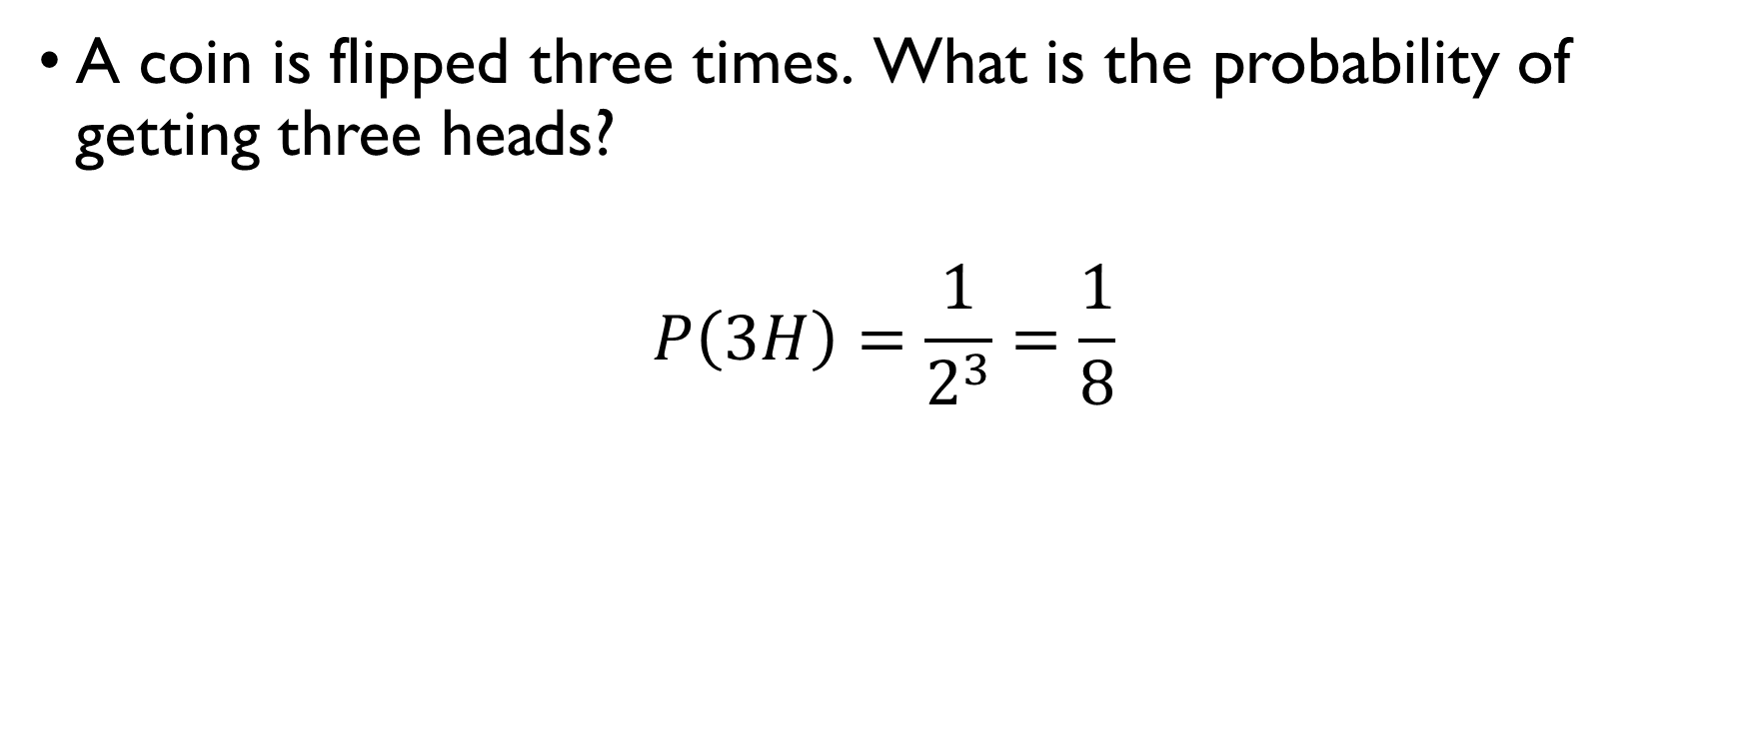
three coin flips
A coin is flipped three times. What is the probability of getting three heads?
$$P\left(3H\right)=\frac{1}{2^{3}}=\frac{1}{8}$$

Slide 9
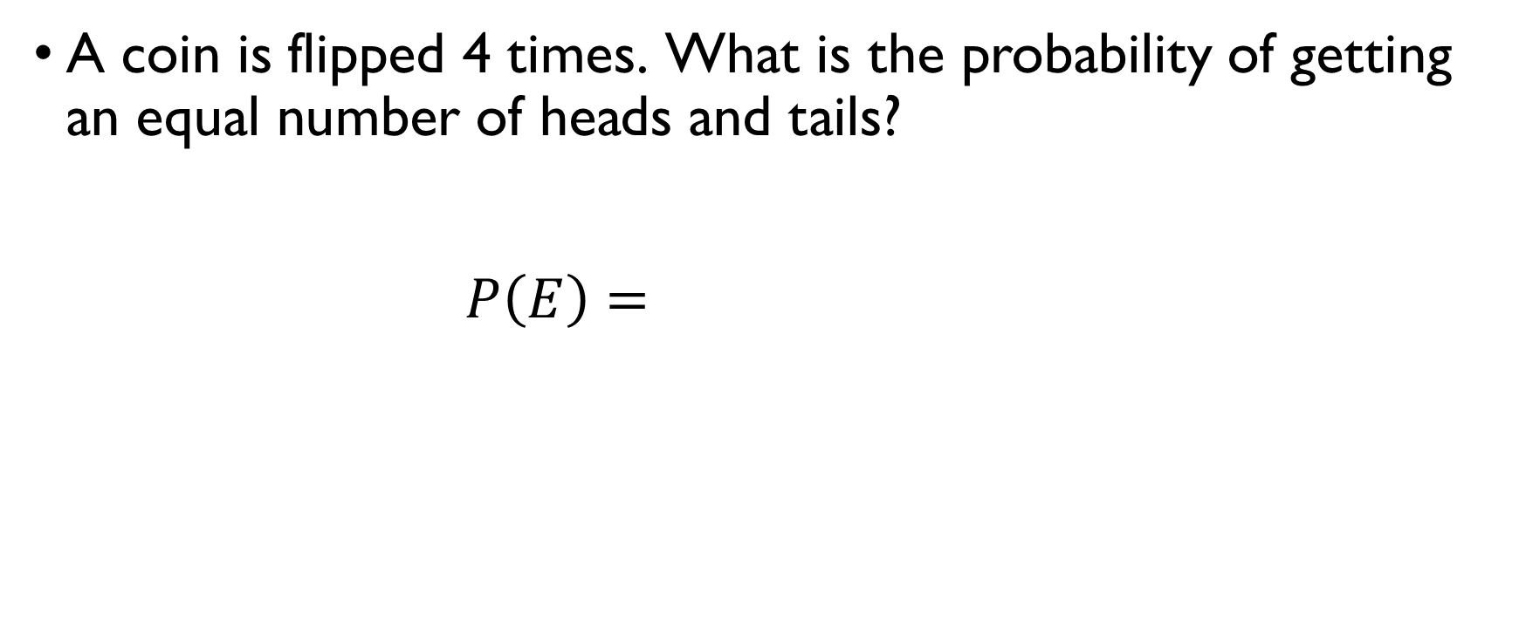
Four coin flips
A coin is flipped 4 times. What is the probability of getting an equal number of heads and tails?
$$P\left(E\right)=\frac{C\left(4, 2\right)}{2^{4}}=\frac{4!}{2^{6}}=\frac{3}{8}$$

Slide 10
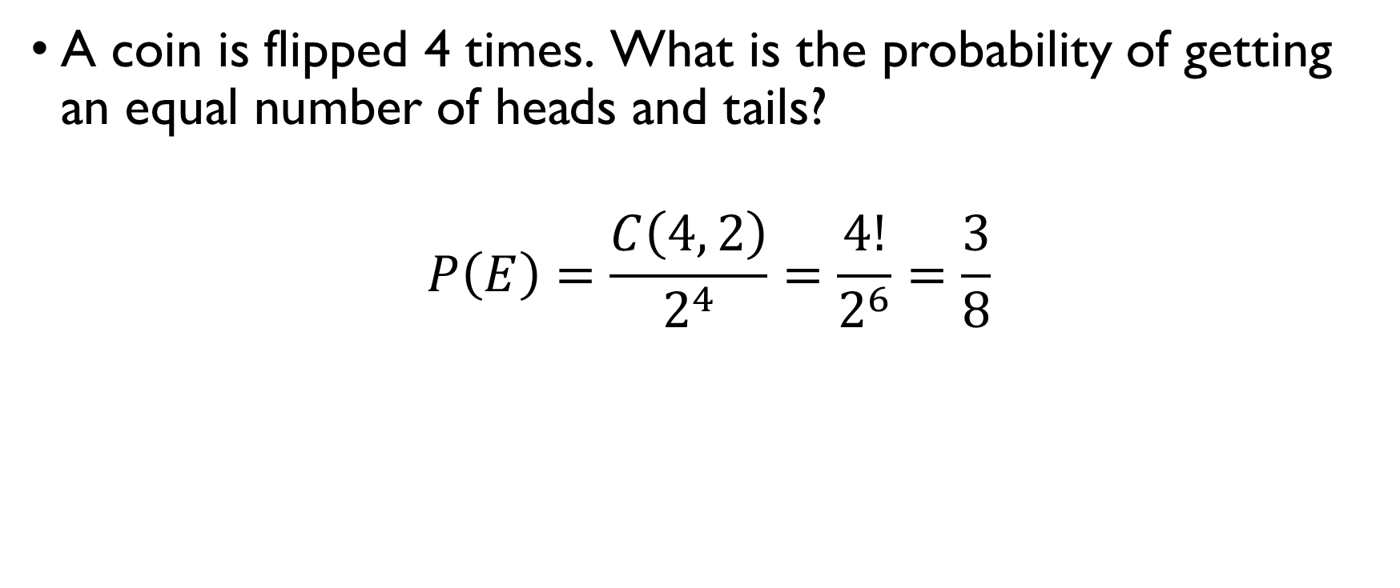
Four coin flips
A coin is flipped 4 times. What is the probability of getting an equal number of heads and tails?
$$P\left(E\right)=\frac{C\left(4, 2\right)}{2^{4}}=\frac{4!}{2^{6}}=\frac{3}{8}$$

Slide 11
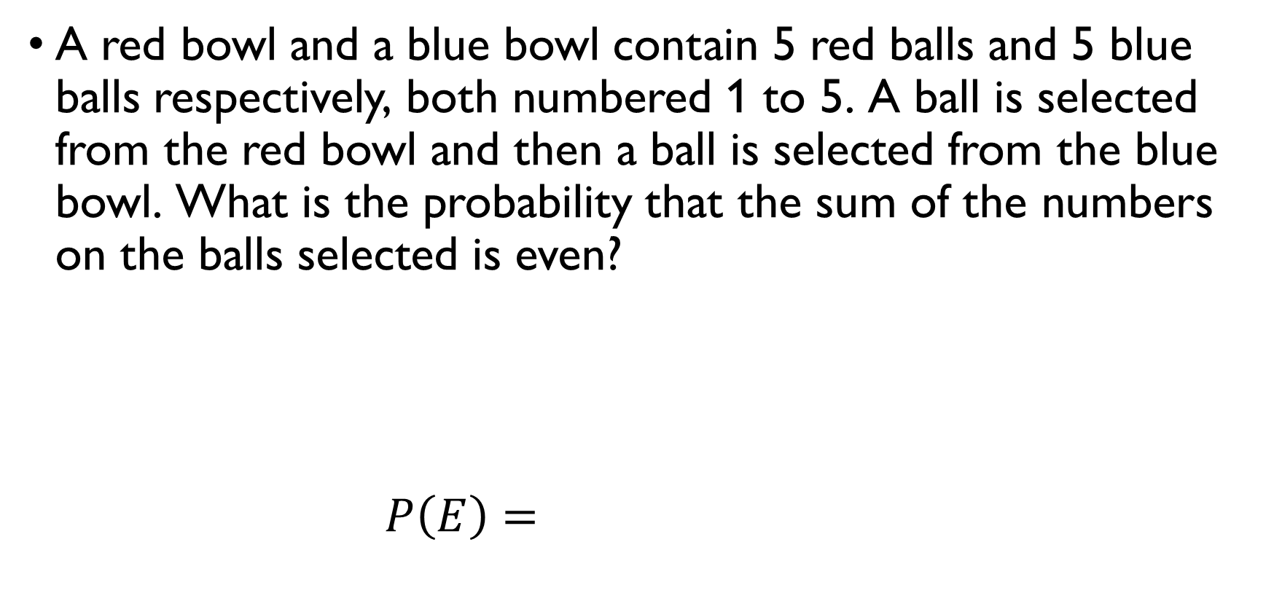
Numbered balls
A red bowl and a blue bowl contain 5 red balls and 5 blue balls respectively, both numbered 1 to 5. A ball is selected from the red bowl and then a ball is selected from the blue bowl. What is the probability that the sum of the numbers on the balls selected is even?
Sum is even = the summands are both even or both odd
$$P\left(E\right)=\frac{2⋅2+3⋅3}{5⋅5}=\frac{13}{25}$$

Slide 12
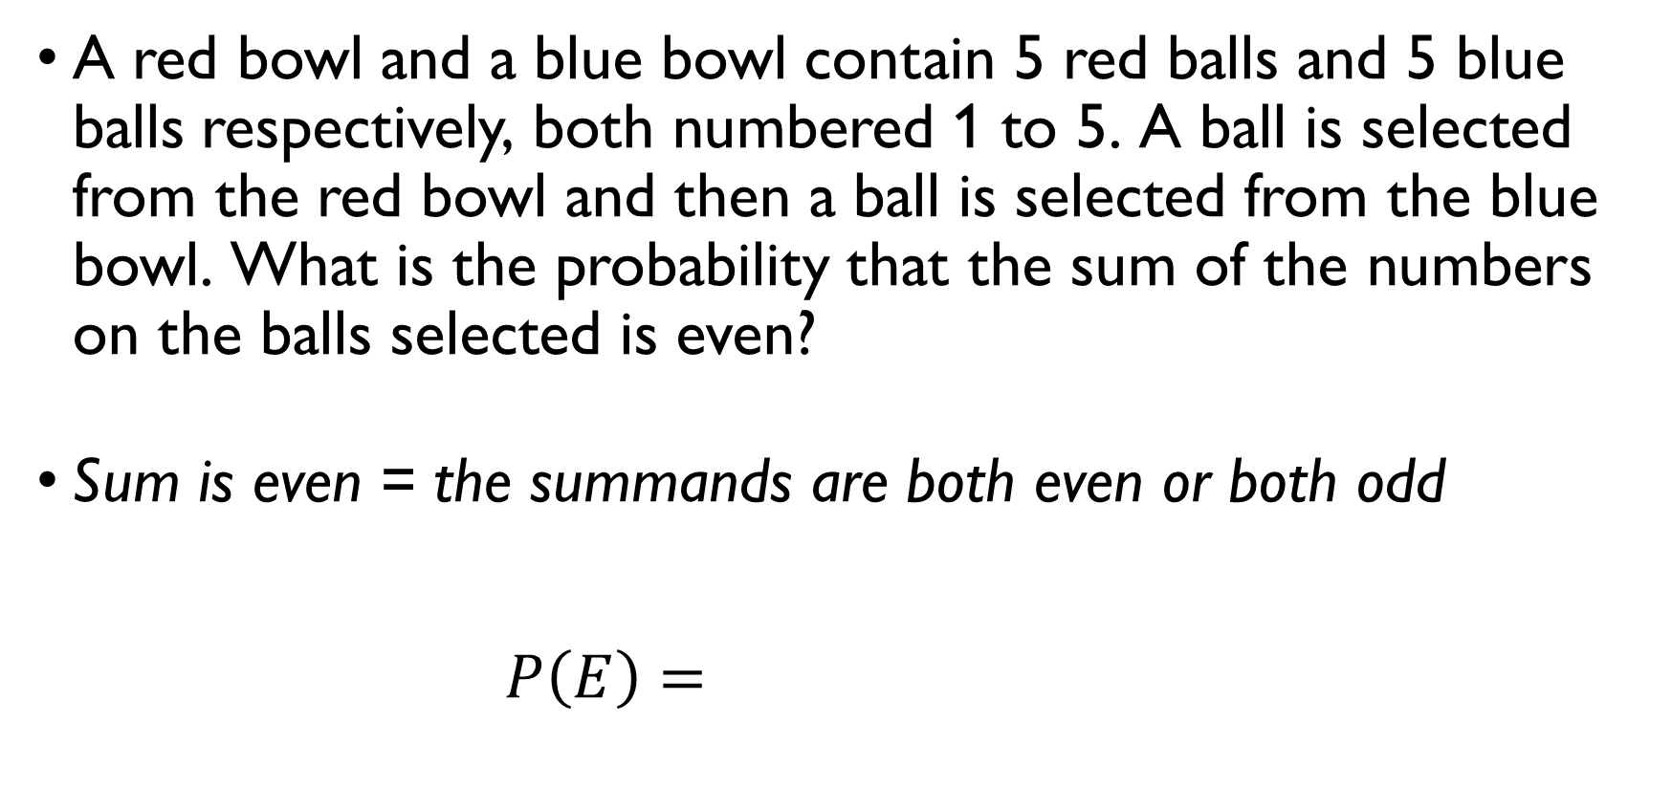
Numbered balls
A red bowl and a blue bowl contain 5 red balls and 5 blue balls respectively, both numbered 1 to 5. A ball is selected from the red bowl and then a ball is selected from the blue bowl. What is the probability that the sum of the numbers on the balls selected is even?
Sum is even = the summands are both even or both odd
$$P\left(E\right)=\frac{2⋅2+3⋅3}{5⋅5}=\frac{13}{25}$$

Slide 13
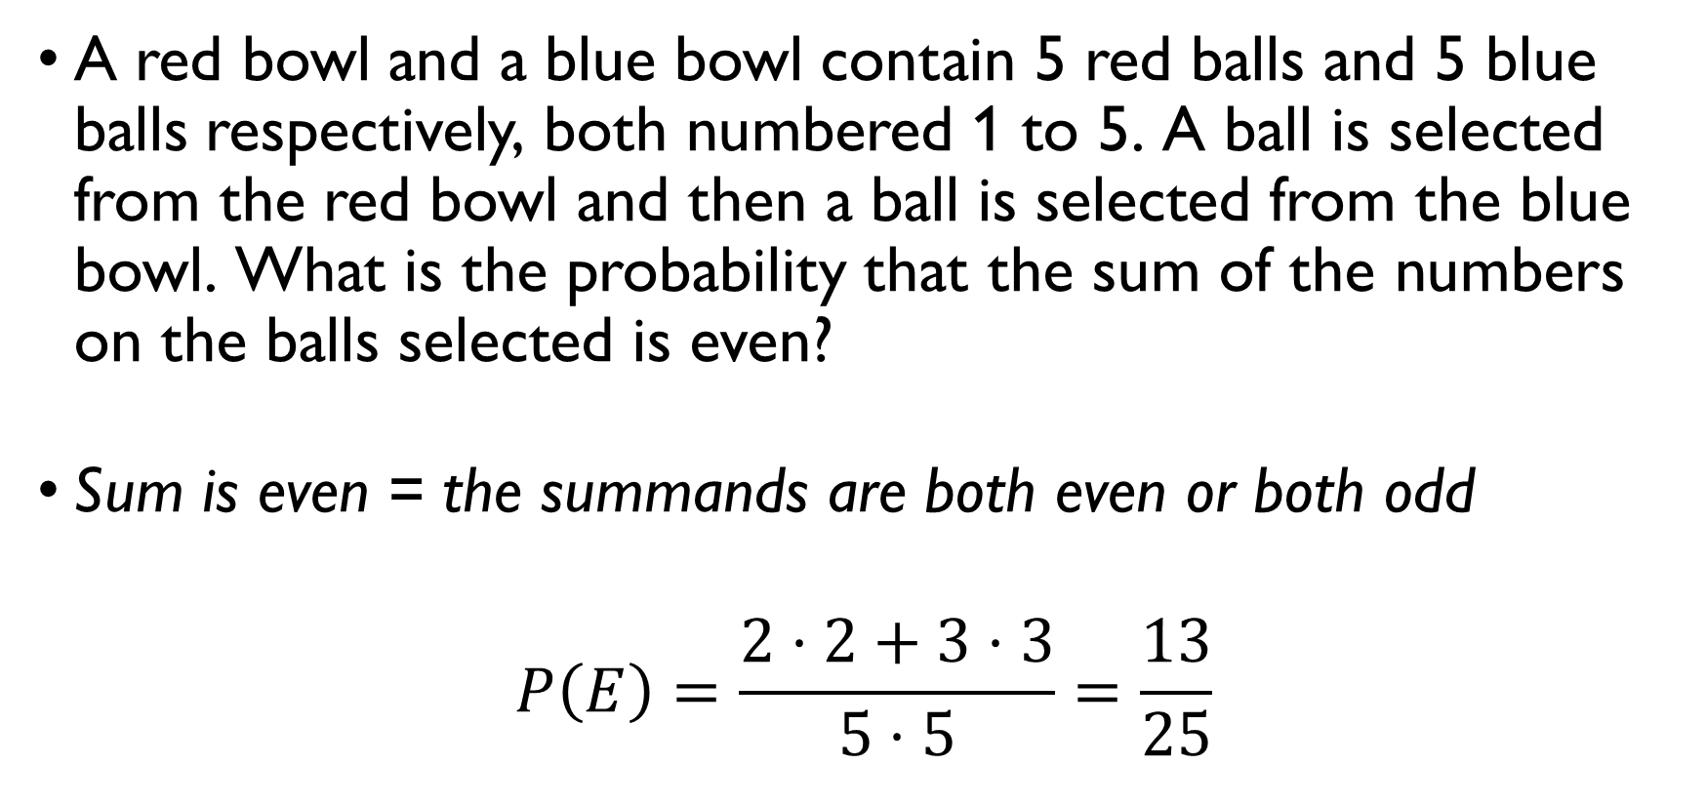
Numbered balls
A red bowl and a blue bowl contain 5 red balls and 5 blue balls respectively, both numbered 1 to 5. A ball is selected from the red bowl and then a ball is selected from the blue bowl. What is the probability that the sum of the numbers on the balls selected is even?
Sum is even = the summands are both even or both odd
$$P\left(E\right)=\frac{2⋅2+3⋅3}{5⋅5}=\frac{13}{25}$$

Slide 14
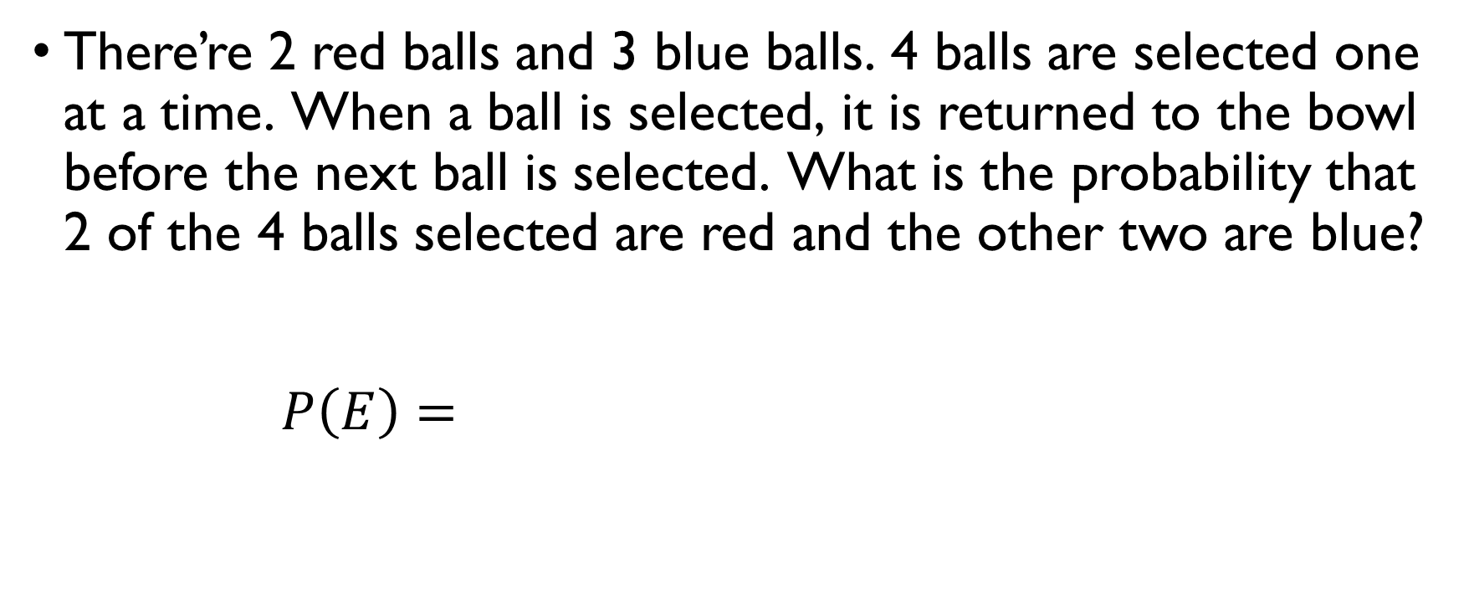
More balls
There’re 2 red balls and 3 blue balls. 4 balls are selected one at a time. When a ball is selected, it is returned to the bowl before the next ball is selected. What is the probability that 2 of the 4 balls selected are red and the other two are blue?
$$P\left(E\right)=\frac{C\left(4, 2\right)⋅2^{2}⋅3^{2}}{5^{4}}=\frac{6^{3}}{5^{4}}=0.3456$$

Slide 15
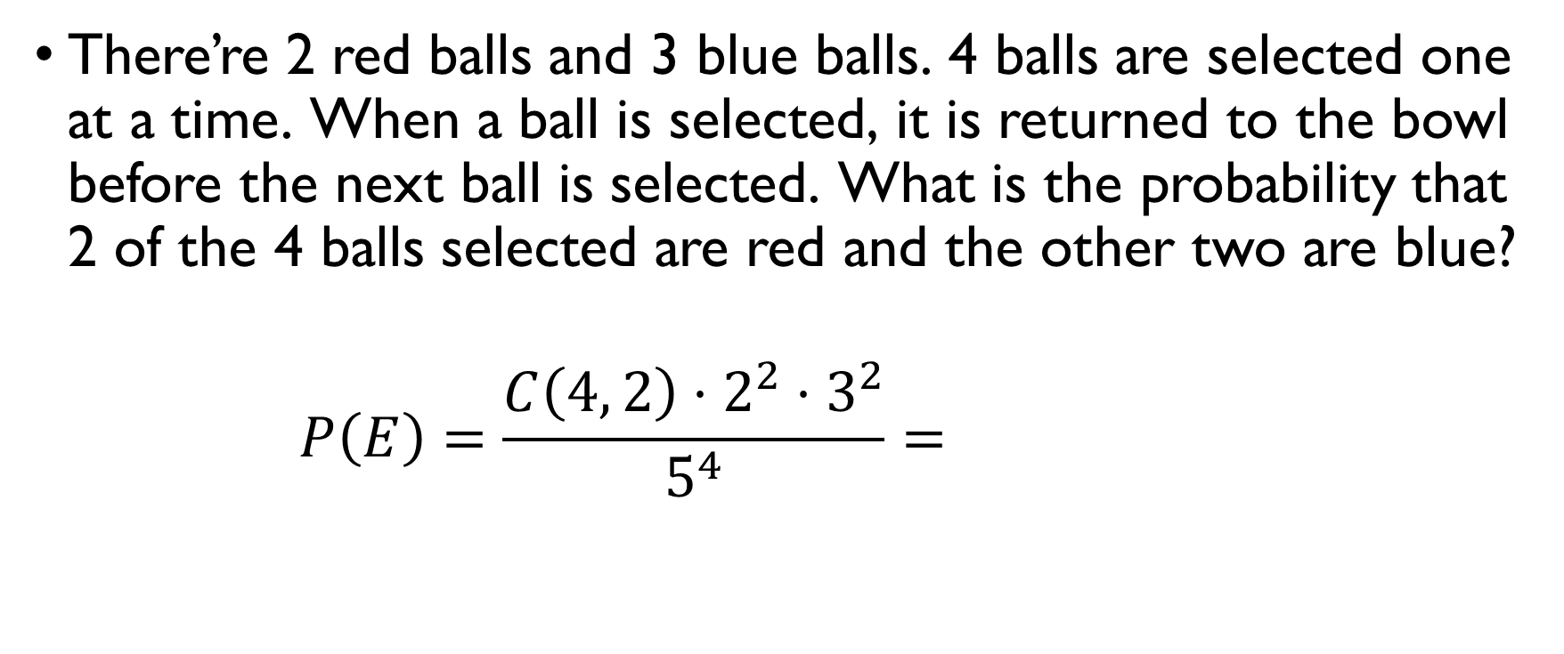
More balls
There’re 2 red balls and 3 blue balls. 4 balls are selected one at a time. When a ball is selected, it is returned to the bowl before the next ball is selected. What is the probability that 2 of the 4 balls selected are red and the other two are blue?
$$P\left(E\right)=\frac{C\left(4, 2\right)⋅2^{2}⋅3^{2}}{5^{4}}=\frac{6^{3}}{5^{4}}=0.3456$$

Slide 16
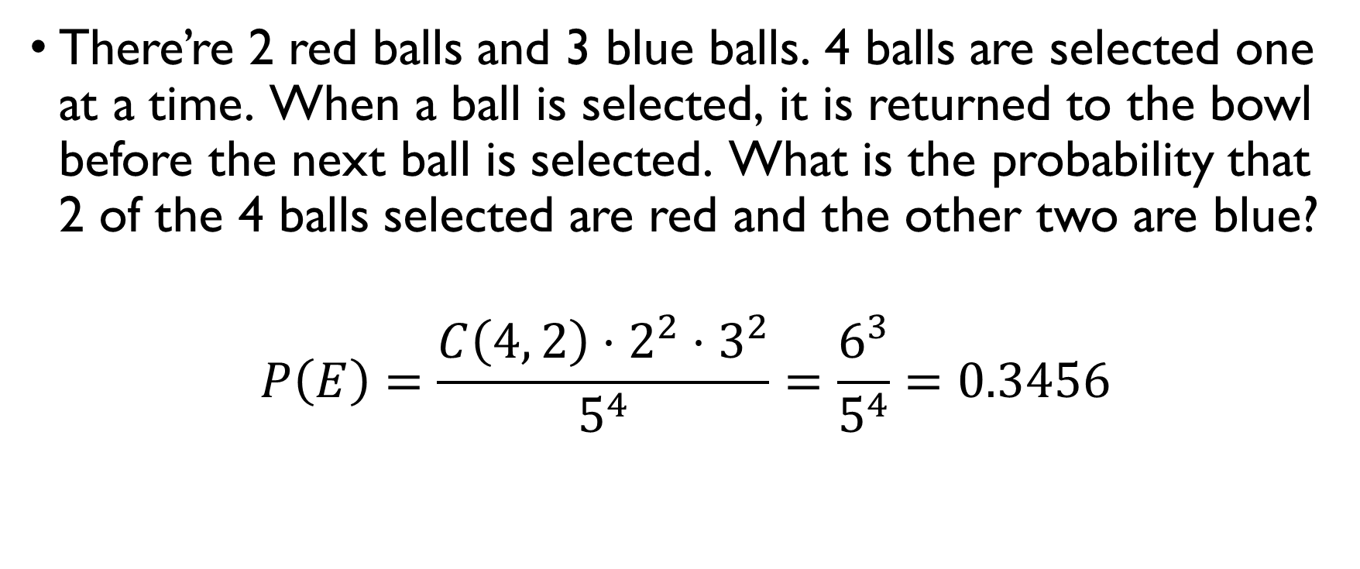
More balls
There’re 2 red balls and 3 blue balls. 4 balls are selected one at a time. When a ball is selected, it is returned to the bowl before the next ball is selected. What is the probability that 2 of the 4 balls selected are red and the other two are blue?
$$P\left(E\right)=\frac{C\left(4, 2\right)⋅2^{2}⋅3^{2}}{5^{4}}=\frac{6^{3}}{5^{4}}=0.3456$$

Slide 17
Conditional probability

Slide 18
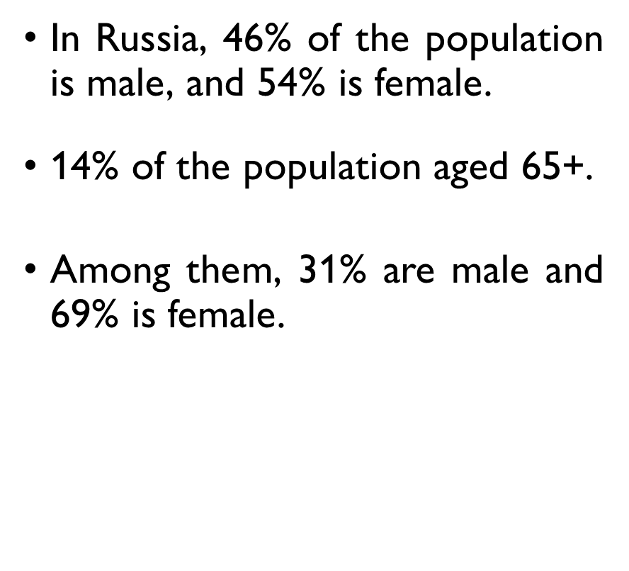
EXAMPLE: DEMOGRAPHICS
In Russia, 46% of the population is male, and 54% is female.
14% of the population aged 65+.
Among them, 31% are male and 69% is female.
So, men aged 65+ are 4.3% ($0.31⋅0.14 = 0.0434$) of the population.
The probability to be male is 0.46.
The probabilityto be aged 65+ is 0.14.
The conditional probability of being a male given age 65+ is 0.31.
Joint probability of being a man and aged 65+ is 0.0434.

Slide 19
EXAMPLE: DEMOGRAPHICS
In Russia, 46% of the population is male, and 54% is female.
14% of the population aged 65+.
Among them, 31% are male and 69% is female.
So, men aged 65+ are 4.3% of the population.
The probability to be male is 0.46.
The probabilityto be aged 65+ is 0.14.
The conditional probability of being a male given age 65+ is 0.31.
Joint probability of being a man and aged 65+ is 0.0434.

Slide 20
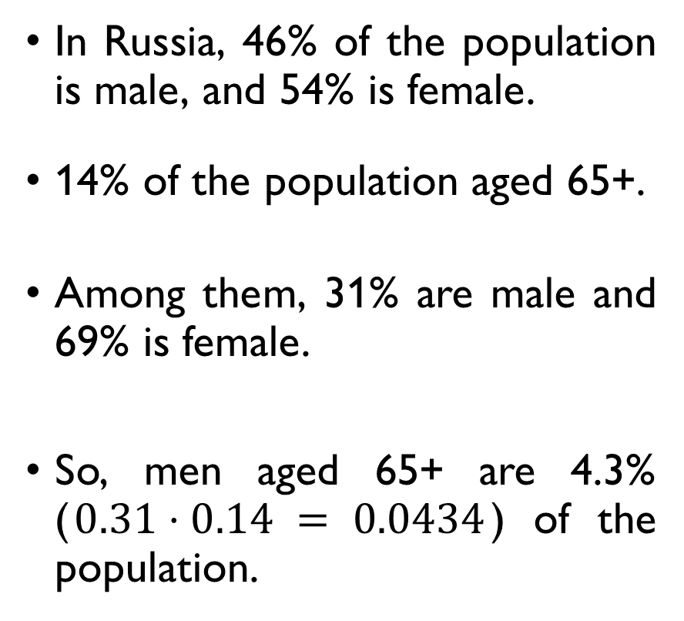
EXAMPLE: DEMOGRAPHICS
In Russia, 46% of the population is male, and 54% is female.
14% of the population aged 65+.
Among them, 31% are male and 69% is female.
So, men aged 65+ are 4.3% ($0.31⋅0.14 = 0.0434$) of the population.
The probability to be male is 0.46.
The probabilityto be aged 65+ is 0.14.
The conditional probability of being a male given age 65+ is 0.31.
Joint probability of being a man and aged 65+ is 0.0434.

Slide 21
EXAMPLE: DEMOGRAPHICS
In Russia, 46% of the population is male, and 54% is female.
14% of the population aged 65+.
Among them, 31% are male and 69% is female.
So, men aged 65+ are 4.3% ($0.31⋅0.14 = 0.0434$) of the population.
The probability to be male is 0.46.
The probabilityto be aged 65+ is 0.14.
The conditional probability of being a male given age 65+ is 0.31.
Joint probability of being a man and aged 65+ is 0.0434.

Slide 22
EXAMPLE: DEMOGRAPHICS
In Russia, 46% of the population is male, and 54% is female.
14% of the population aged 65+.
Among them, 31% are male and 69% is female.
So, men aged 65+ are 4.3% ($0.31⋅0.14 = 0.0434$) of the population.
The probability to be male is 0.46.
The probability to be aged 65+ is 0.14.
The conditional probability of being a male given age 65+ is 0.31.
Joint probability of being a man and aged 65+ is 0.0434.

Slide 23
EXAMPLE: DEMOGRAPHICS
In Russia, 46% of the population is male, and 54% is female.
14% of the population aged 65+.
Among them, 31% are male and 69% is female.
So, men aged 65+ are 4.3% ($0.31⋅0.14 = 0.0434$) of the population.
The probability to be male is 0.46.
The probability to be aged 65+ is 0.14.
The conditional probability of being a male given age 65+ is 0.31.
Joint probability of being a man and aged 65+ is 0.0434.

Slide 24
EXAMPLE: DEMOGRAPHICS
In Russia, 46% of the population is male, and 54% is female.
14% of the population aged 65+.
Among them, 31% are male and 69% is female.
So, men aged 65+ are 4.3% ($0.31⋅0.14 = 0.0434$) of the population.
The probability to be male is 0.46.
The probability to be aged 65+ is 0.14.
The conditional probability of being a male given age 65+ is 0.31.
Joint probability of being a man and aged 65+ is 0.0434.

Slide 25
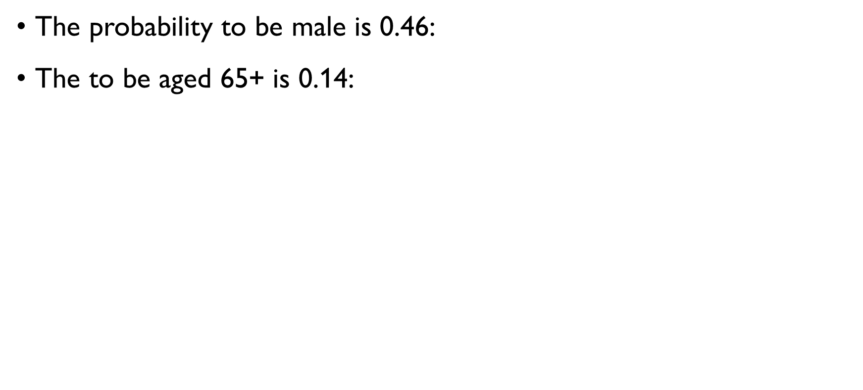
EXAMPLE: DEMOGRAPHICS
The probability to be male is 0.46: $P\left(M\right)=0.46$
The to be aged 65+ is 0.14: $P\left(65+\right)=0.14$
The conditional probability of being a male given age 65+ is 0.31:
$$P\left(M|65+\right)=0.31$$
Joint probability of being a man and aged 65+ is 0.0434:
$$P\left(M \& 65+\right)=0.0434$$
Note: $P\left(M \&65+\right)=P\left(M|65+\right)⋅P\left(65+\right)$

Slide 26
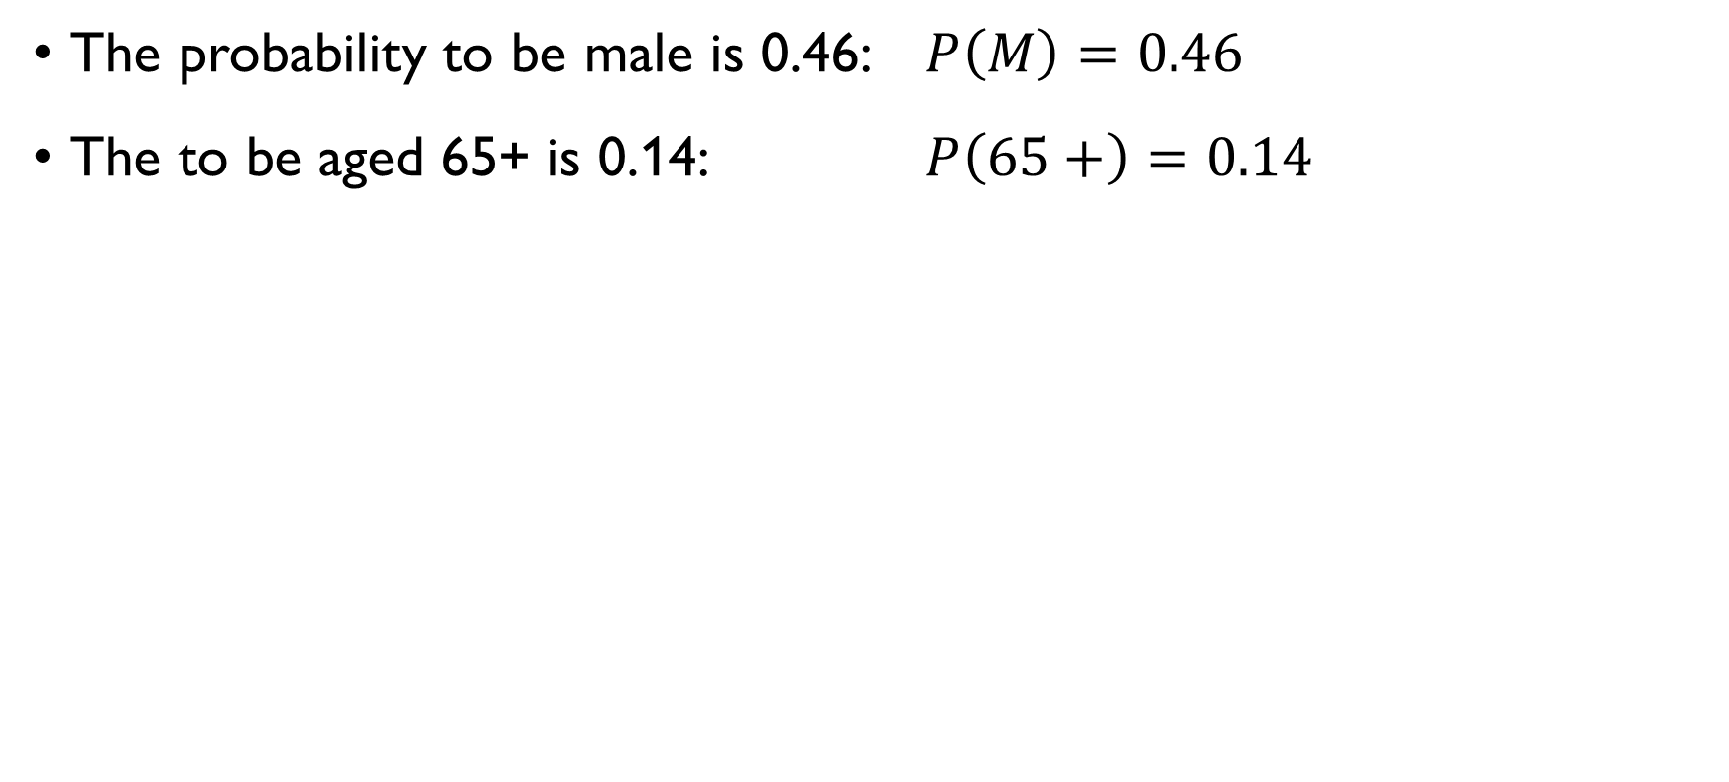
EXAMPLE: DEMOGRAPHICS
The probability to be male is 0.46: $P\left(M\right)=0.46$
The to be aged 65+ is 0.14: $P\left(65+\right)=0.14$
The conditional probability of being a male given age 65+ is 0.31:
$$P\left(M|65+\right)=0.31$$
Joint probability of being a man and aged 65+ is 0.0434:
$$P\left(M \& 65+\right)=0.0434$$
Note: $P\left(M \&65+\right)=P\left(M|65+\right)⋅P\left(65+\right)$

Slide 27
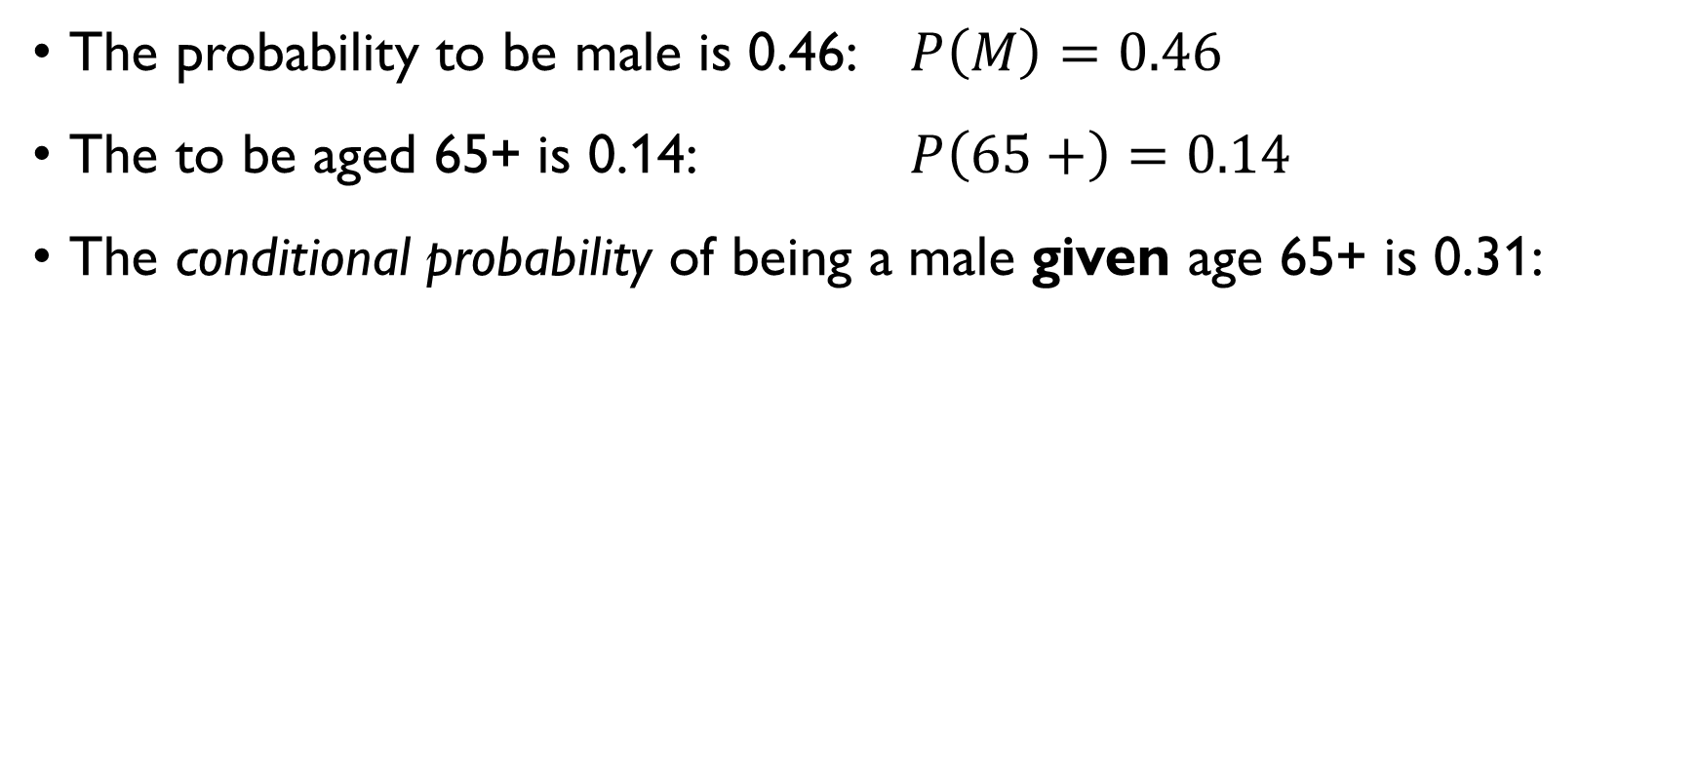
EXAMPLE: DEMOGRAPHICS
The probability to be male is 0.46: $P\left(M\right)=0.46$
The to be aged 65+ is 0.14: $P\left(65+\right)=0.14$
The conditional probability of being a male given age 65+ is 0.31:
$$P\left(M|65+\right)=0.31$$
Joint probability of being a man and aged 65+ is 0.0434:
$$P\left(M \& 65+\right)=0.0434$$
Note: $P\left(M \&65+\right)=P\left(M|65+\right)⋅P\left(65+\right)$

Slide 28
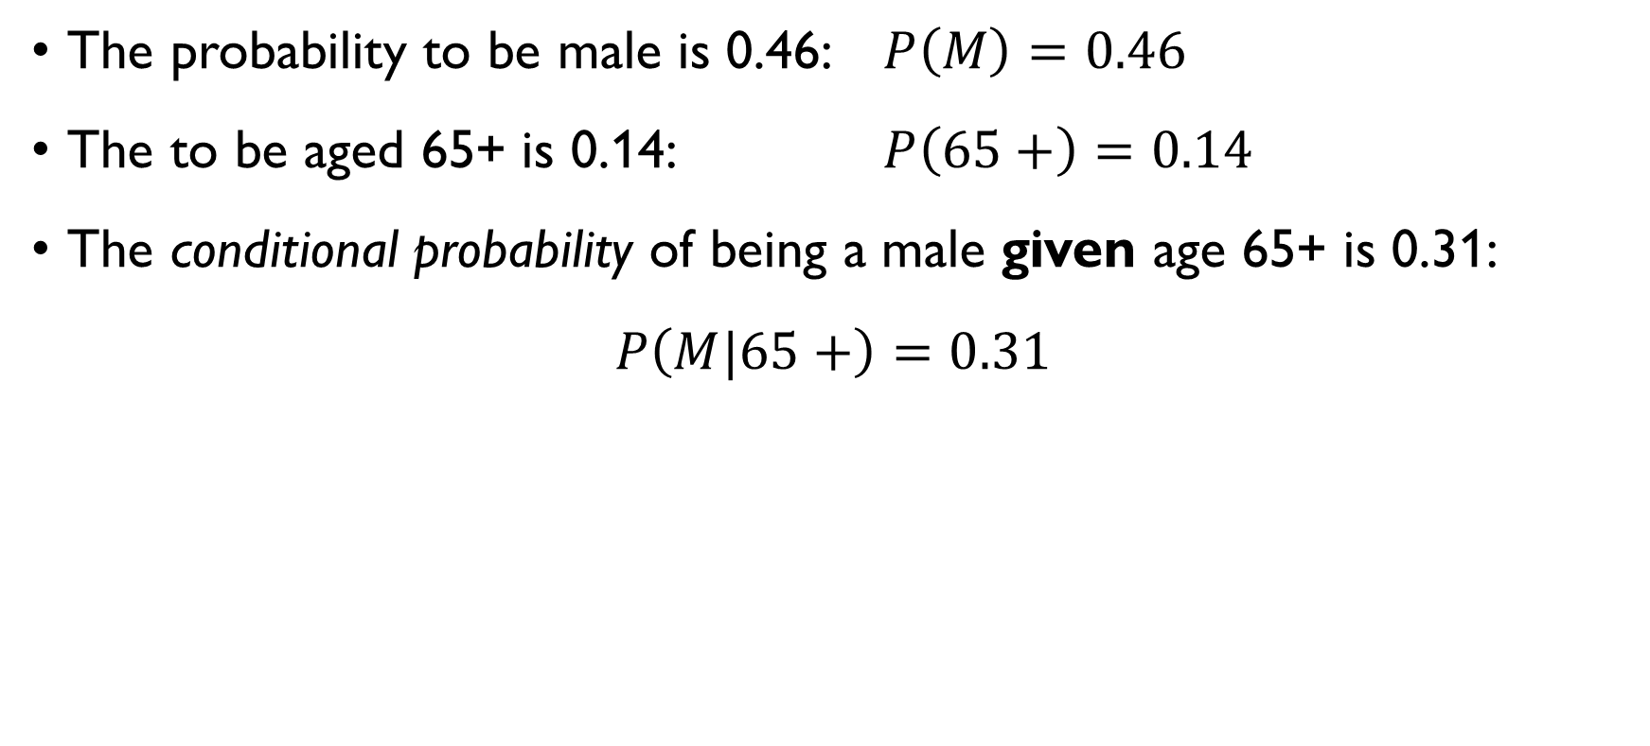
EXAMPLE: DEMOGRAPHICS
The probability to be male is 0.46: $P\left(M\right)=0.46$
The to be aged 65+ is 0.14: $P\left(65+\right)=0.14$
The conditional probability of being a male given age 65+ is 0.31:
$$P\left(M|65+\right)=0.31$$
Joint probability of being a man and aged 65+ is 0.0434:
$$P\left(M \& 65+\right)=0.0434$$
Note: $P\left(M \&65+\right)=P\left(M|65+\right)⋅P\left(65+\right)$

Slide 29
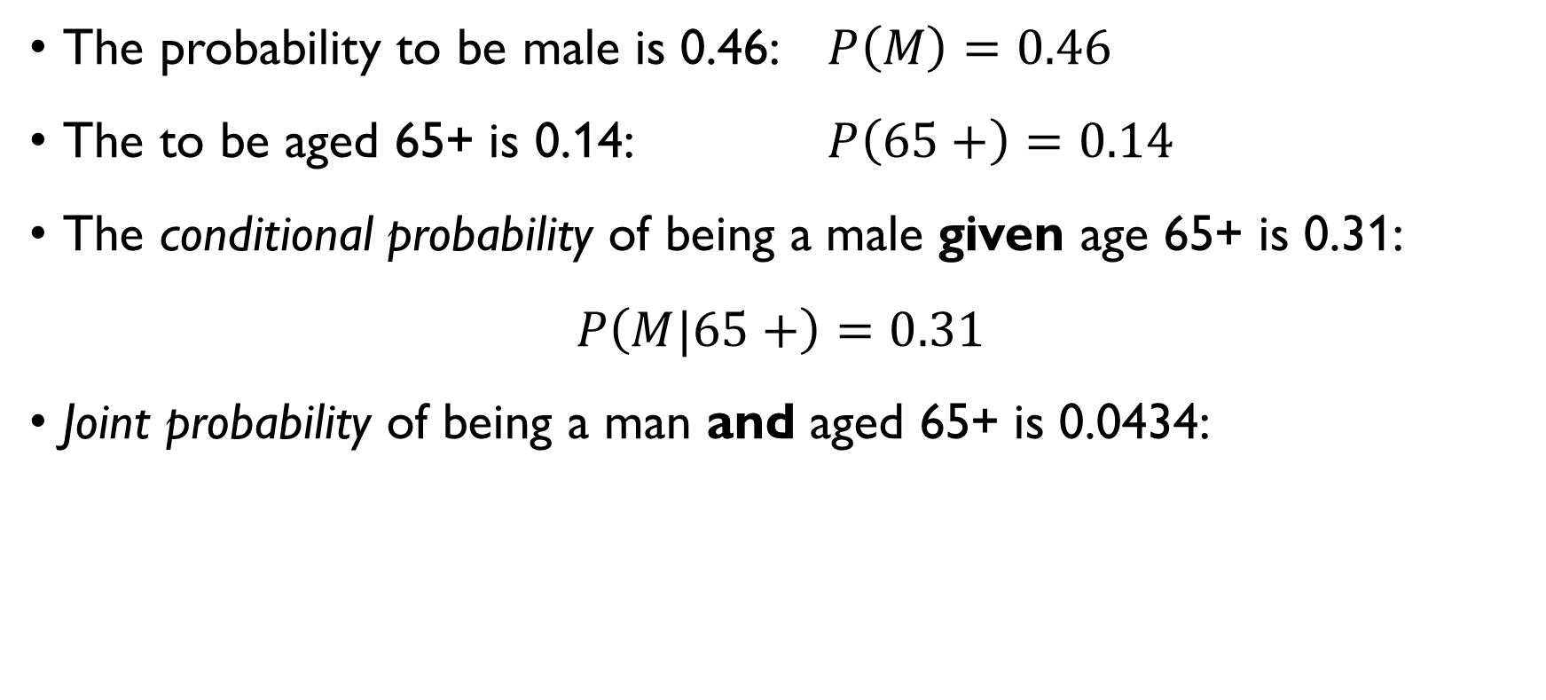
EXAMPLE: DEMOGRAPHICS
The probability to be male is 0.46: $P\left(M\right)=0.46$
The to be aged 65+ is 0.14: $P\left(65+\right)=0.14$
The conditional probability of being a male given age 65+ is 0.31:
$$P\left(M|65+\right)=0.31$$
Joint probability of being a man and aged 65+ is 0.0434:
$$P\left(M \& 65+\right)=0.0434$$
Note: $P\left(M \&65+\right)=P\left(M|65+\right)⋅P\left(65+\right)$

Slide 30
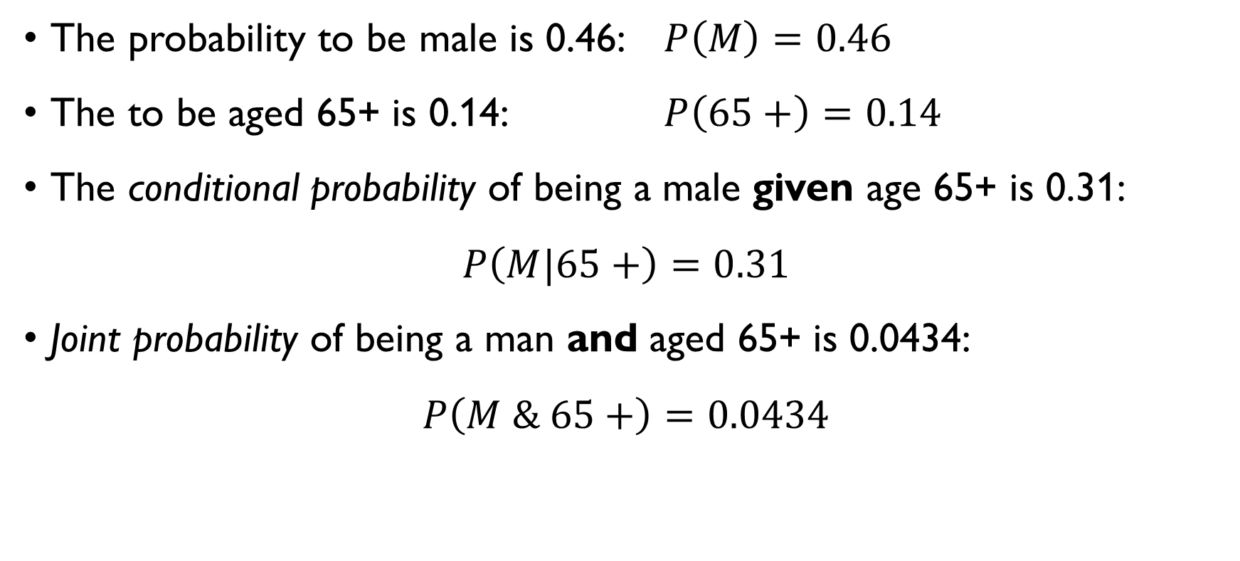
EXAMPLE: DEMOGRAPHICS
The probability to be male is 0.46: $P\left(M\right)=0.46$
The to be aged 65+ is 0.14: $P\left(65+\right)=0.14$
The conditional probability of being a male given age 65+ is 0.31:
$$P\left(M|65+\right)=0.31$$
Joint probability of being a man and aged 65+ is 0.0434:
$$P\left(M \& 65+\right)=0.0434$$
Note: $P\left(M \&65+\right)=P\left(M|65+\right)⋅P\left(65+\right)$

Slide 31
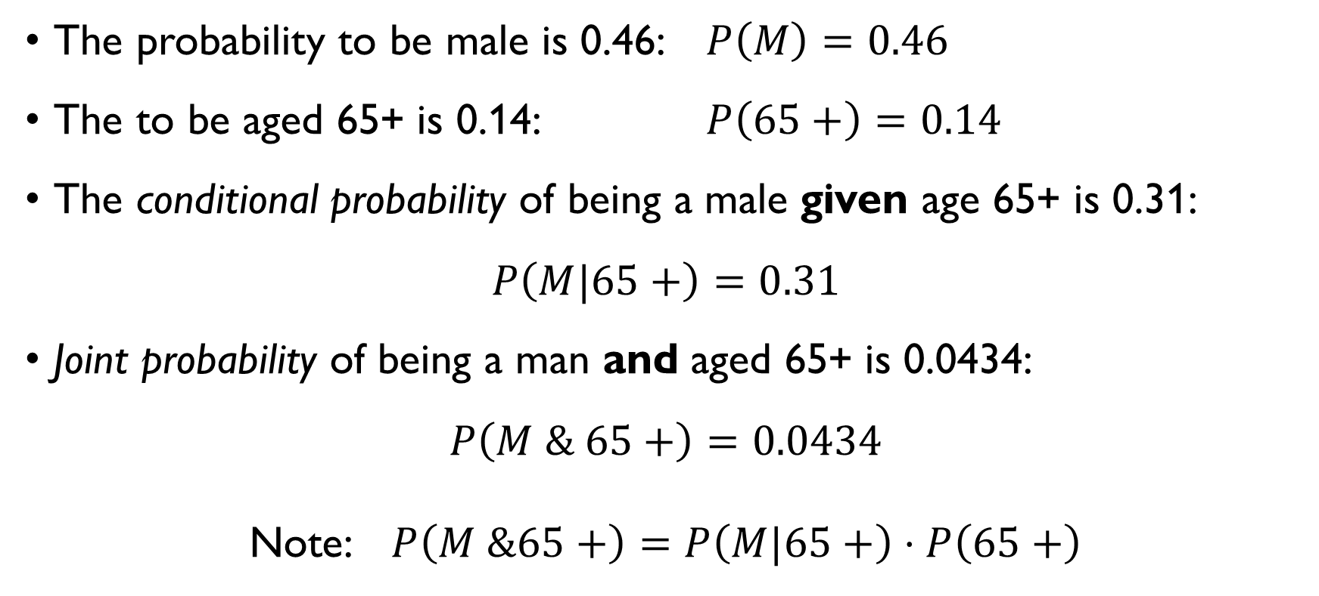
EXAMPLE: DEMOGRAPHICS
The probability to be male is 0.46: $P\left(M\right)=0.46$
The to be aged 65+ is 0.14: $P\left(65+\right)=0.14$
The conditional probability of being a male given age 65+ is 0.31:
$$P\left(M|65+\right)=0.31$$
Joint probability of being a man and aged 65+ is 0.0434:
$$P\left(M \& 65+\right)=0.0434$$
Note: $P\left(M \&65+\right)=P\left(M|65+\right)⋅P\left(65+\right)$

Slide 32
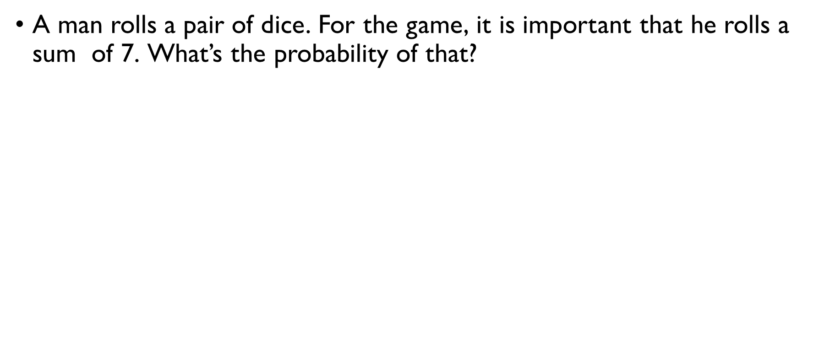
Example: rolling a die
A man rolls a pair of dice. For the game, it is important that he rolls a sum of 7. What’s the probability of that?
$$P\left(X_{1}+X_{2}=7\right)=\frac{6}{6⋅6}=\frac{1}{6}≈0.167$$
The other player is not wearing her glasses and is unable to see the outcome, but sees that there is more than one spot on each die. What is the probability of getting 7 now?
$$P\left(X_{1}+X_{2}=7|multiple spots\right)=\frac{4}{5⋅5}=\frac{4}{25}=0.16$$

Slide 33
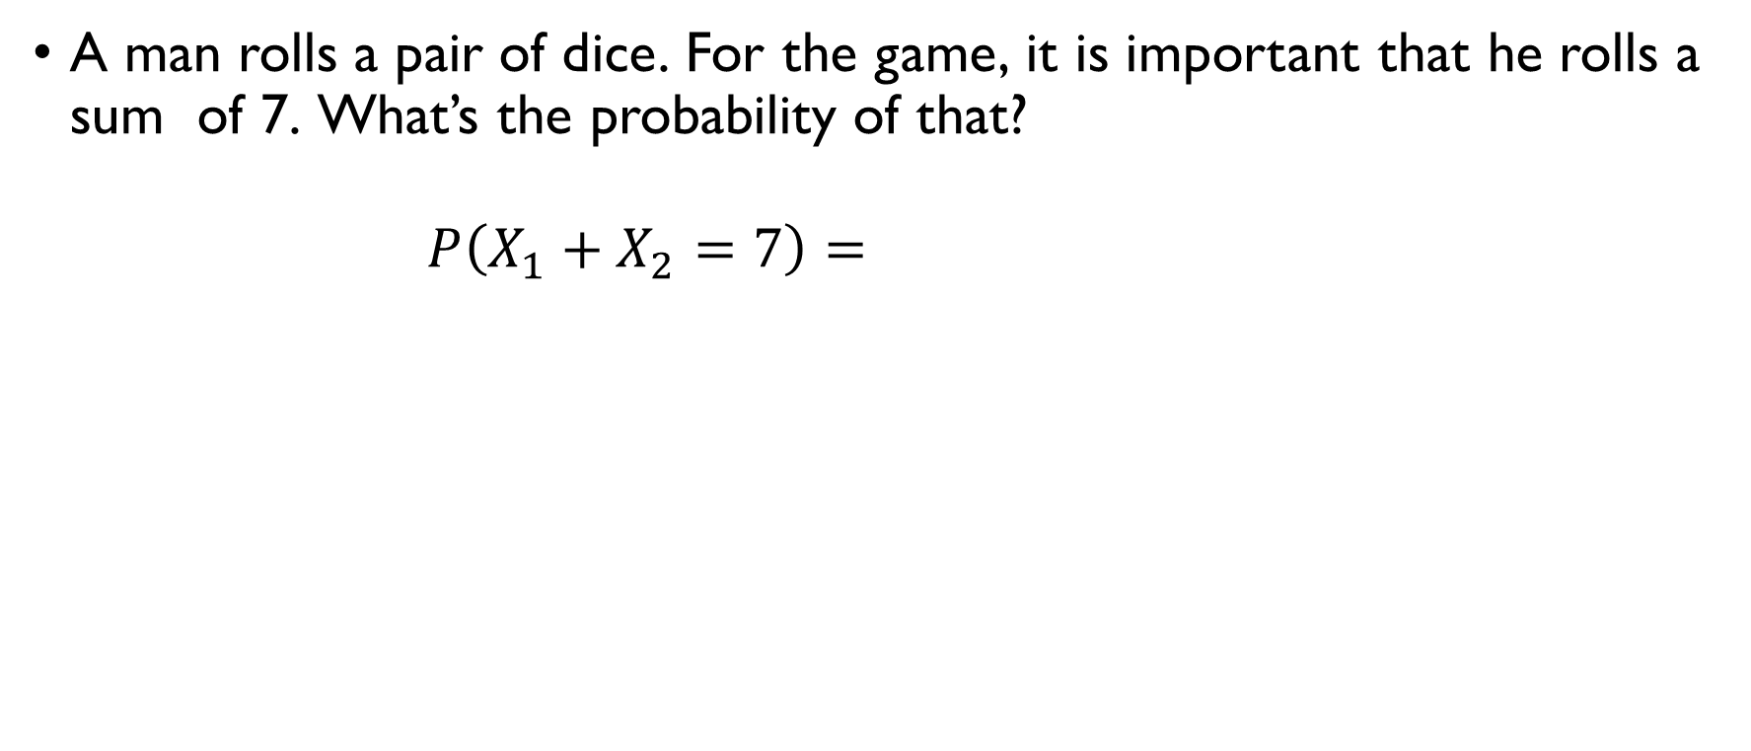
Example: rolling a die
A man rolls a pair of dice. For the game, it is important that he rolls a sum of 7. What’s the probability of that?
$$P\left(X_{1}+X_{2}=7\right)=\frac{6}{6⋅6}=\frac{1}{6}≈0.167$$
The other player is not wearing her glasses and is unable to see the outcome, but sees that there is more than one spot on each die. What is the probability of getting 7 now?
$$P\left(X_{1}+X_{2}=7|multiple spots\right)=\frac{4}{5⋅5}=\frac{4}{25}=0.16$$

Slide 34
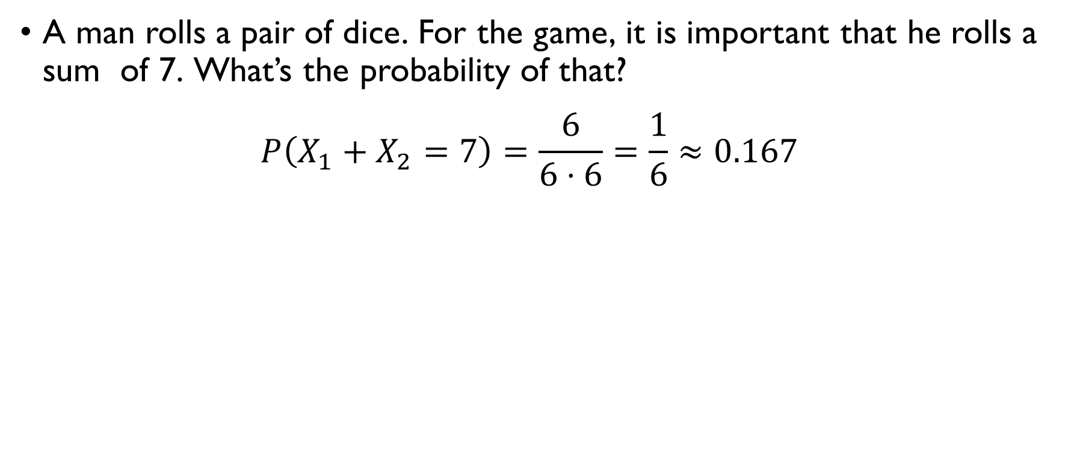
Example: rolling a die
A man rolls a pair of dice. For the game, it is important that he rolls a sum of 7. What’s the probability of that?
$$P\left(X_{1}+X_{2}=7\right)=\frac{6}{6⋅6}=\frac{1}{6}≈0.167$$
The other player is not wearing her glasses and is unable to see the outcome, but sees that there is more than one spot on each die. What is the probability of getting 7 now?
$$P\left(X_{1}+X_{2}=7|multiple spots\right)=\frac{4}{5⋅5}=\frac{4}{25}=0.16$$

Slide 35
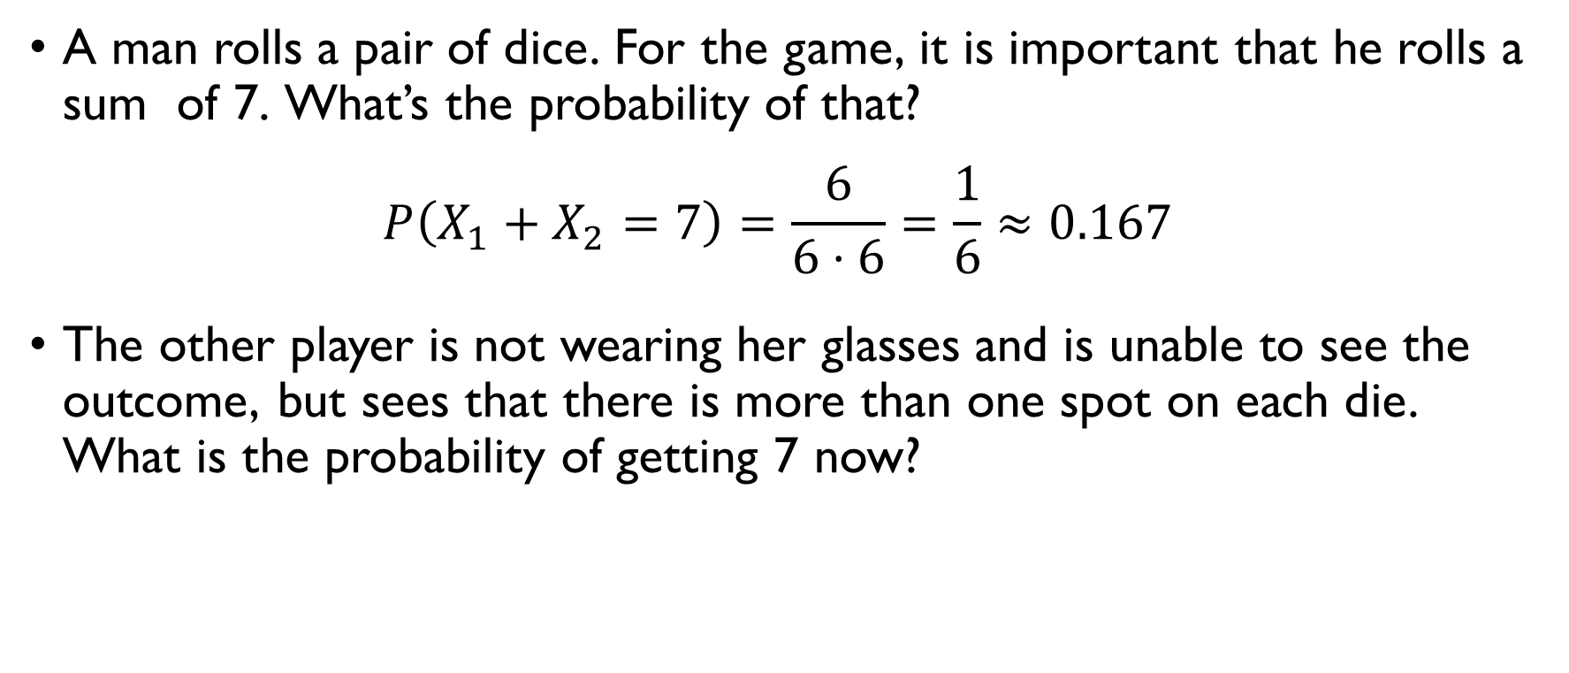
Example: rolling a die
A man rolls a pair of dice. For the game, it is important that he rolls a sum of 7. What’s the probability of that?
$$P\left(X_{1}+X_{2}=7\right)=\frac{6}{6⋅6}=\frac{1}{6}≈0.167$$
The other player is not wearing her glasses and is unable to see the outcome, but sees that there is more than one spot on each die. What is the probability of getting 7 now?
$$P\left(X_{1}+X_{2}=7|multiple spots\right)=\frac{4}{5⋅5}=\frac{4}{25}=0.16$$

Slide 36
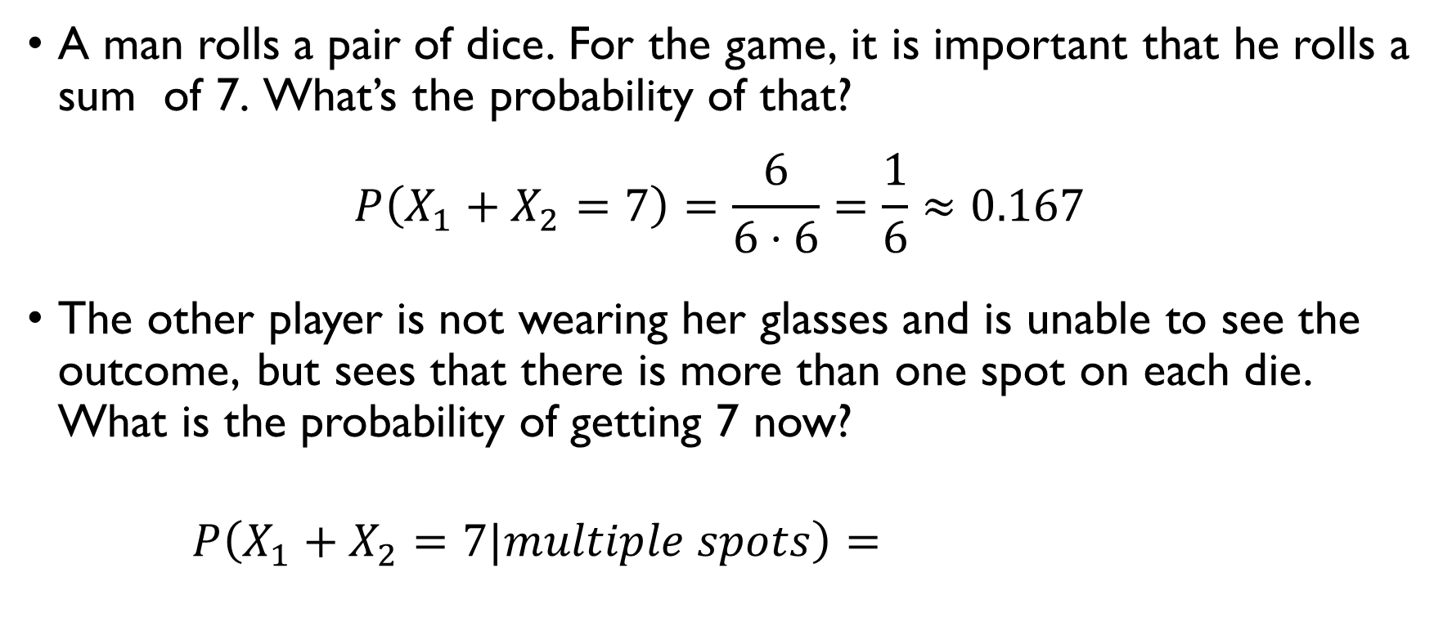
Example: rolling a die
A man rolls a pair of dice. For the game, it is important that he rolls a sum of 7. What’s the probability of that?
$$P\left(X_{1}+X_{2}=7\right)=\frac{6}{6⋅6}=\frac{1}{6}≈0.167$$
The other player is not wearing her glasses and is unable to see the outcome, but sees that there is more than one spot on each die. What is the probability of getting 7 now?
$$P\left(X_{1}+X_{2}=7|multiple spots\right)=\frac{4}{5⋅5}=\frac{4}{25}=0.16$$

Slide 37
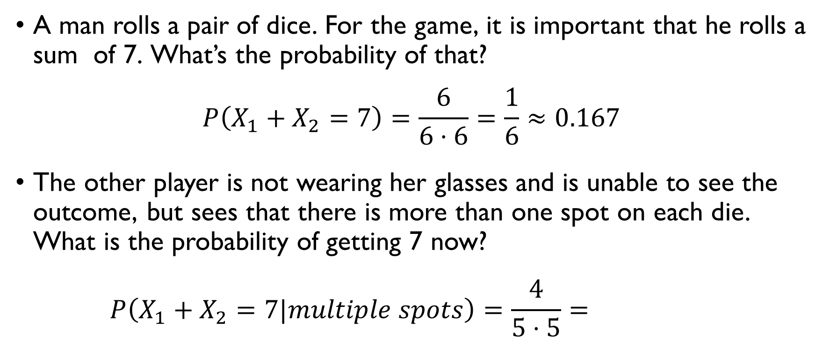
Example: rolling a die
A man rolls a pair of dice. For the game, it is important that he rolls a sum of 7. What’s the probability of that?
$$P\left(X_{1}+X_{2}=7\right)=\frac{6}{6⋅6}=\frac{1}{6}≈0.167$$
The other player is not wearing her glasses and is unable to see the outcome, but sees that there is more than one spot on each die. What is the probability of getting 7 now?
$$P\left(X_{1}+X_{2}=7|multiple spots\right)=\frac{4}{5⋅5}=\frac{4}{25}=0.16$$

Slide 38
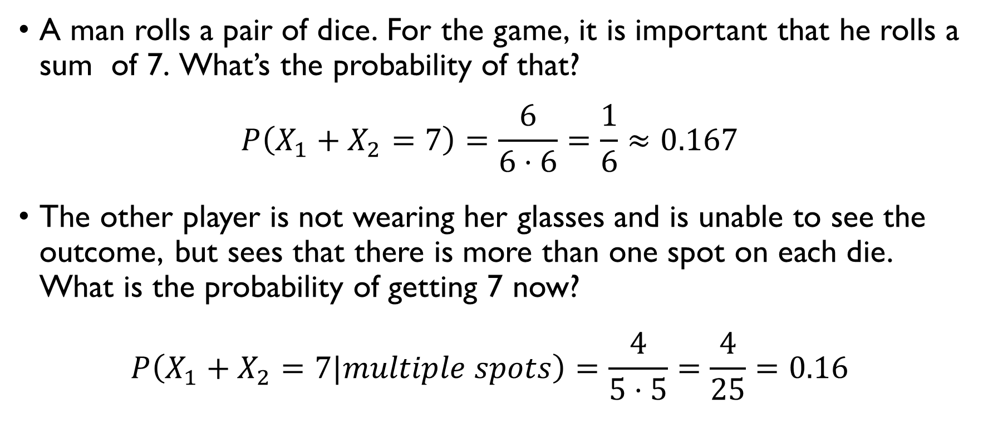
Example: rolling a die
A man rolls a pair of dice. For the game, it is important that he rolls a sum of 7. What’s the probability of that?
$$P\left(X_{1}+X_{2}=7\right)=\frac{6}{6⋅6}=\frac{1}{6}≈0.167$$
The other player is not wearing her glasses and is unable to see the outcome, but sees that there is more than one spot on each die. What is the probability of getting 7 now?
$$P\left(X_{1}+X_{2}=7|multiple spots\right)=\frac{4}{5⋅5}=\frac{4}{25}=0.16$$

Slide 39
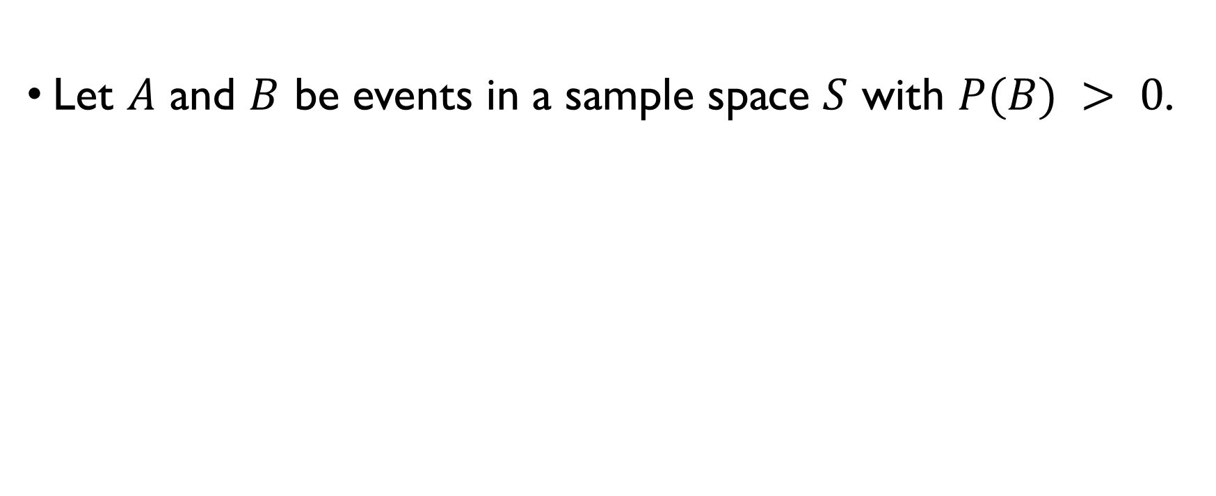
Conditional probability
Let $A$ and $B$ be events in a sample space $S$ with $P(B) > 0$.
Then the conditional probability of the event $A$ given that event $B$ has occurred is
$$P\left(A|B\right)=\frac{P\left(A∩B\right)}{P\left(B\right)}=\frac{P\left(AB\right)}{P(B)}=\frac{P\left(A \& B\right)}{P(B)}$$

Slide 40
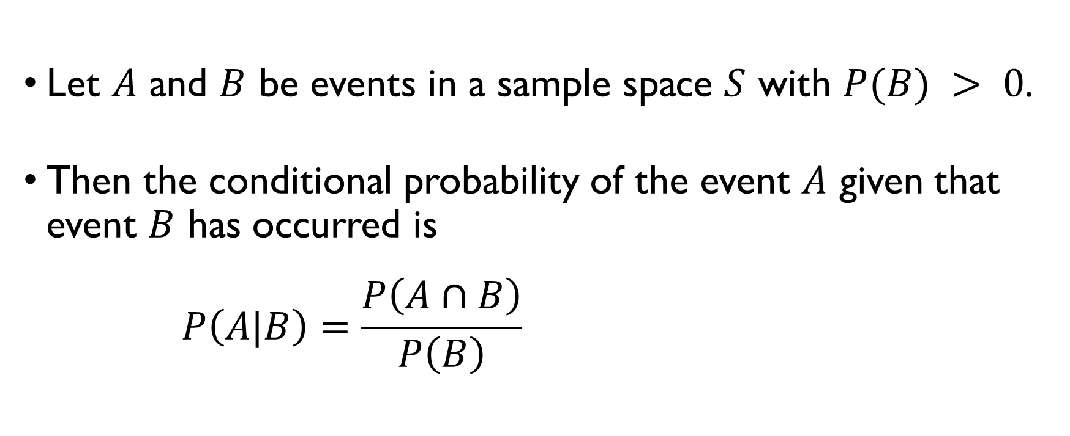
Conditional probability
Let $A$ and $B$ be events in a sample space $S$ with $P(B) > 0$.
Then the conditional probability of the event $A$ given that event $B$ has occurred is
$$P\left(A|B\right)=\frac{P\left(A∩B\right)}{P\left(B\right)}=\frac{P\left(AB\right)}{P(B)}=\frac{P\left(A \& B\right)}{P(B)}$$

Slide 41
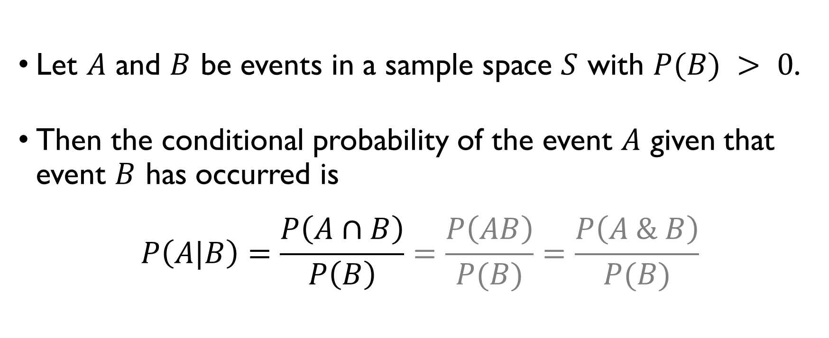
Conditional probability
Let $A$ and $B$ be events in a sample space $S$ with $P(B) > 0$.
Then the conditional probability of the event $A$ given that event $B$ has occurred is
$$P\left(A|B\right)=\frac{P\left(A∩B\right)}{P\left(B\right)}=\frac{P\left(AB\right)}{P(B)}=\frac{P\left(A \& B\right)}{P(B)}$$

Slide 42
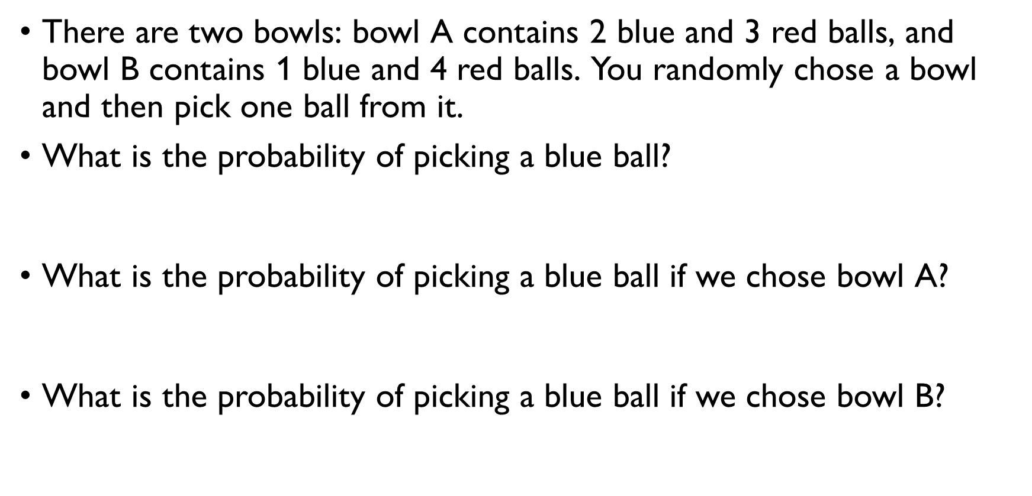
Bowls and balls
There are two bowls: bowl A contains 2 blue and 3 red balls, and bowl B contains 1 blue and 4 red balls. You randomly chose a bowl and then pick one ball from it.
What is the probability of picking a blue ball?
$$P\left(Blue\right)=\frac{2+1}{5+5}=\frac{3}{10}$$
What is the probability of picking a blue ball if we chose bowl A?
$$P\left(Blue|A\right)=\frac{2}{5}$$
What is the probability of picking a blue ball if we chose bowl B?
$$P\left(Blue|B\right)=\frac{1}{5}$$

Slide 43
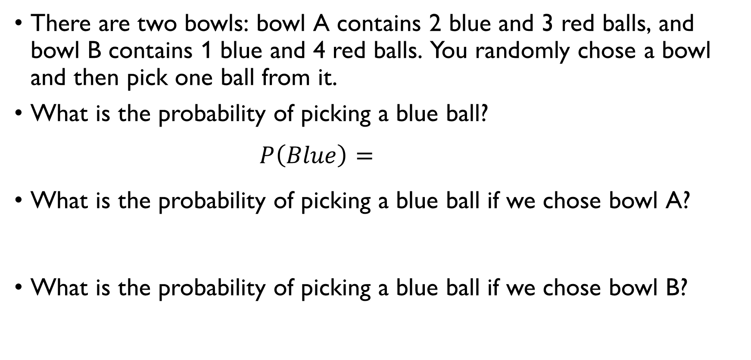
Bowls and balls
There are two bowls: bowl A contains 2 blue and 3 red balls, and bowl B contains 1 blue and 4 red balls. You randomly chose a bowl and then pick one ball from it.
What is the probability of picking a blue ball?
$$P\left(Blue\right)=\frac{2+1}{5+5}=\frac{3}{10}$$
What is the probability of picking a blue ball if we chose bowl A?
$$P\left(Blue|A\right)=\frac{2}{5}$$
What is the probability of picking a blue ball if we chose bowl B?
$$P\left(Blue|B\right)=\frac{1}{5}$$

Slide 44
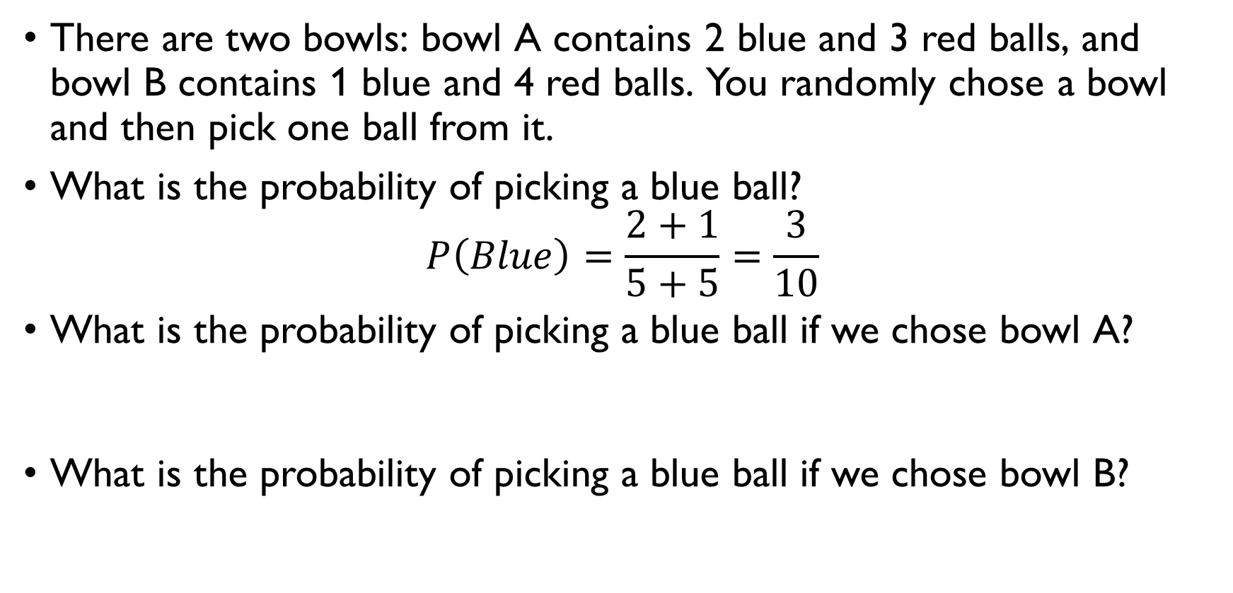
Bowls and balls
There are two bowls: bowl A contains 2 blue and 3 red balls, and bowl B contains 1 blue and 4 red balls. You randomly chose a bowl and then pick one ball from it.
What is the probability of picking a blue ball?
$$P\left(Blue\right)=\frac{2+1}{5+5}=\frac{3}{10}$$
What is the probability of picking a blue ball if we chose bowl A?
$$P\left(Blue|A\right)=\frac{2}{5}$$
What is the probability of picking a blue ball if we chose bowl B?
$$P\left(Blue|B\right)=\frac{1}{5}$$

Slide 45
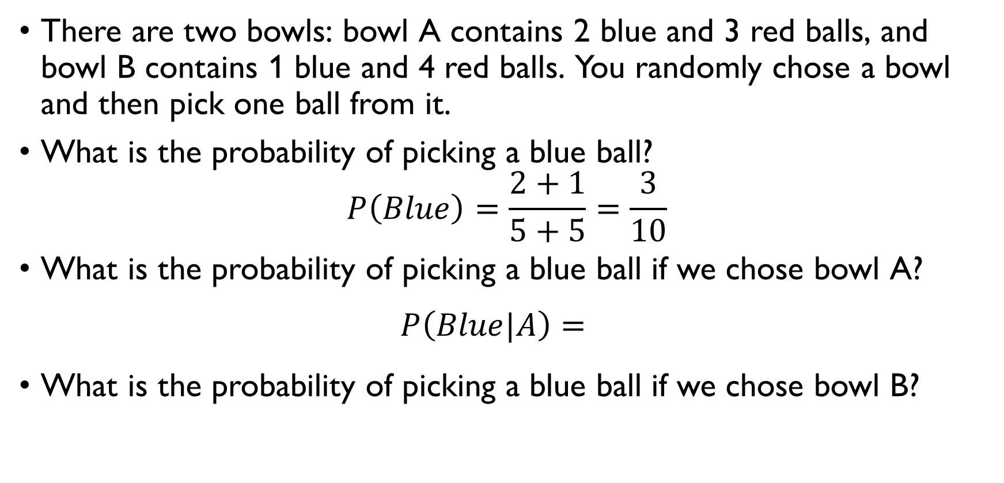
Bowls and balls
There are two bowls: bowl A contains 2 blue and 3 red balls, and bowl B contains 1 blue and 4 red balls. You randomly chose a bowl and then pick one ball from it.
What is the probability of picking a blue ball?
$$P\left(Blue\right)=\frac{2+1}{5+5}=\frac{3}{10}$$
What is the probability of picking a blue ball if we chose bowl A?
$$P\left(Blue|A\right)=\frac{2}{5}$$
What is the probability of picking a blue ball if we chose bowl B?
$$P\left(Blue|B\right)=\frac{1}{5}$$

Slide 46
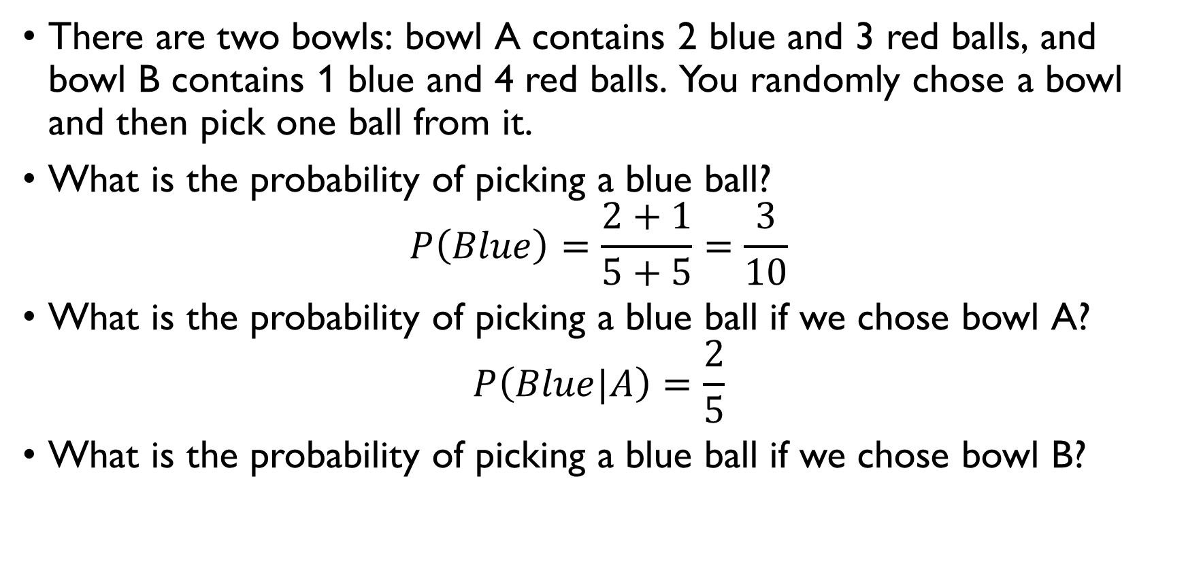
Bowls and balls
There are two bowls: bowl A contains 2 blue and 3 red balls, and bowl B contains 1 blue and 4 red balls. You randomly chose a bowl and then pick one ball from it.
What is the probability of picking a blue ball?
$$P\left(Blue\right)=\frac{2+1}{5+5}=\frac{3}{10}$$
What is the probability of picking a blue ball if we chose bowl A?
$$P\left(Blue|A\right)=\frac{2}{5}$$
What is the probability of picking a blue ball if we chose bowl B?
$$P\left(Blue|B\right)=\frac{1}{5}$$

Slide 47
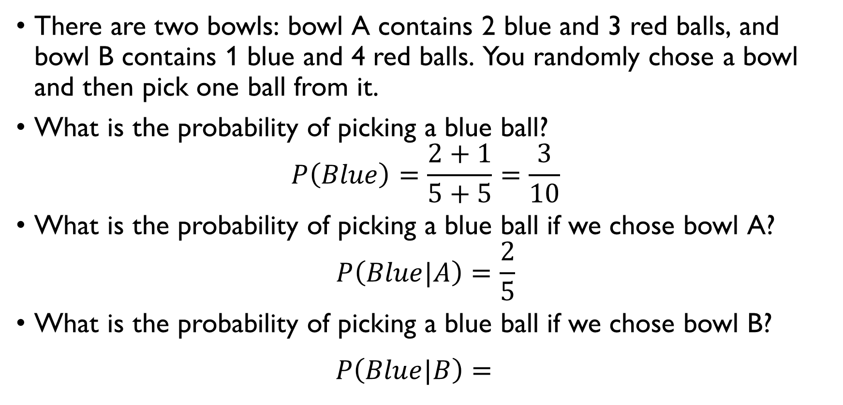
Bowls and balls
There are two bowls: bowl A contains 2 blue and 3 red balls, and bowl B contains 1 blue and 4 red balls. You randomly chose a bowl and then pick one ball from it.
What is the probability of picking a blue ball?
$$P\left(Blue\right)=\frac{2+1}{5+5}=\frac{3}{10}$$
What is the probability of picking a blue ball if we chose bowl A?
$$P\left(Blue|A\right)=\frac{2}{5}$$
What is the probability of picking a blue ball if we chose bowl B?
$$P\left(Blue|B\right)=\frac{1}{5}$$

Slide 48
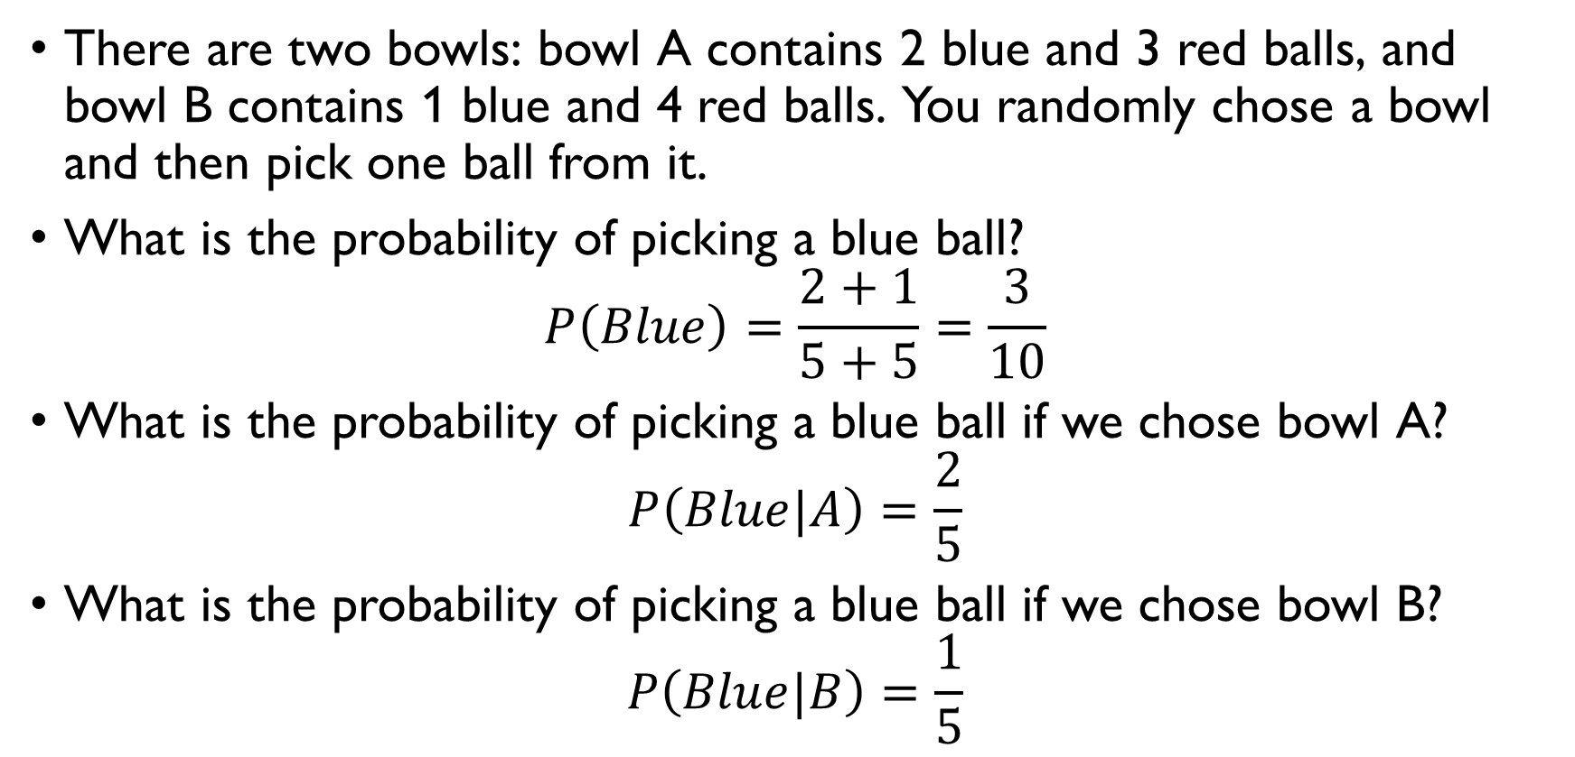
Bowls and balls
There are two bowls: bowl A contains 2 blue and 3 red balls, and bowl B contains 1 blue and 4 red balls. You randomly chose a bowl and then pick one ball from it.
What is the probability of picking a blue ball?
$$P\left(Blue\right)=\frac{2+1}{5+5}=\frac{3}{10}$$
What is the probability of picking a blue ball if we chose bowl A?
$$P\left(Blue|A\right)=\frac{2}{5}$$
What is the probability of picking a blue ball if we chose bowl B?
$$P\left(Blue|B\right)=\frac{1}{5}$$

Slide 49
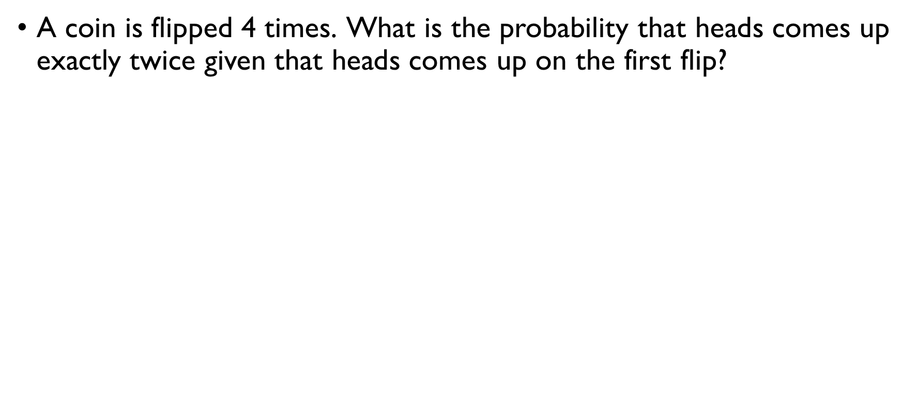
Flipping a coin 1
A coin is flipped 4 times. What is the probability that heads comes up exactly twice given that heads comes up on the first flip? $A−$ H comes up twice $P\left(A\right)=\frac{C\left(4,2\right)}{2^{4}}=\frac{3}{8}$ $B−$ H comes up on the 1st flip $P\left(B\right)=\frac{2^{3}}{2^{4}}=\frac{1}{2}$ $AB$ – H comes up twice incl. on the 1st flip $P\left(AB\right)=\frac{C\left(3, 2\right)}{2^{4}}=\frac{3}{16}$ $P\left(A|B\right)=\frac{3⋅8}{16⋅3}=\frac{1}{2}$

Slide 50
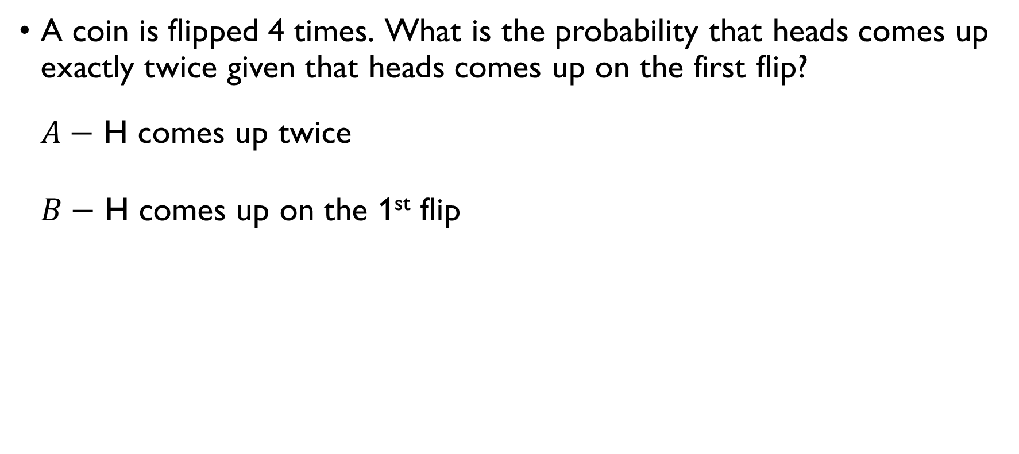
Flipping a coin 1
A coin is flipped 4 times. What is the probability that heads comes up exactly twice given that heads comes up on the first flip? $A−$ H comes up twice $P\left(A\right)=\frac{C\left(4,2\right)}{2^{4}}=\frac{3}{8}$ $B−$ H comes up on the 1st flip $P\left(B\right)=\frac{2^{3}}{2^{4}}=\frac{1}{2}$ $AB$ – H comes up twice incl. on the 1st flip $P\left(AB\right)=\frac{C\left(3, 2\right)}{2^{4}}=\frac{3}{16}$ $P\left(A|B\right)=\frac{3⋅8}{16⋅3}=\frac{1}{2}$

Slide 51
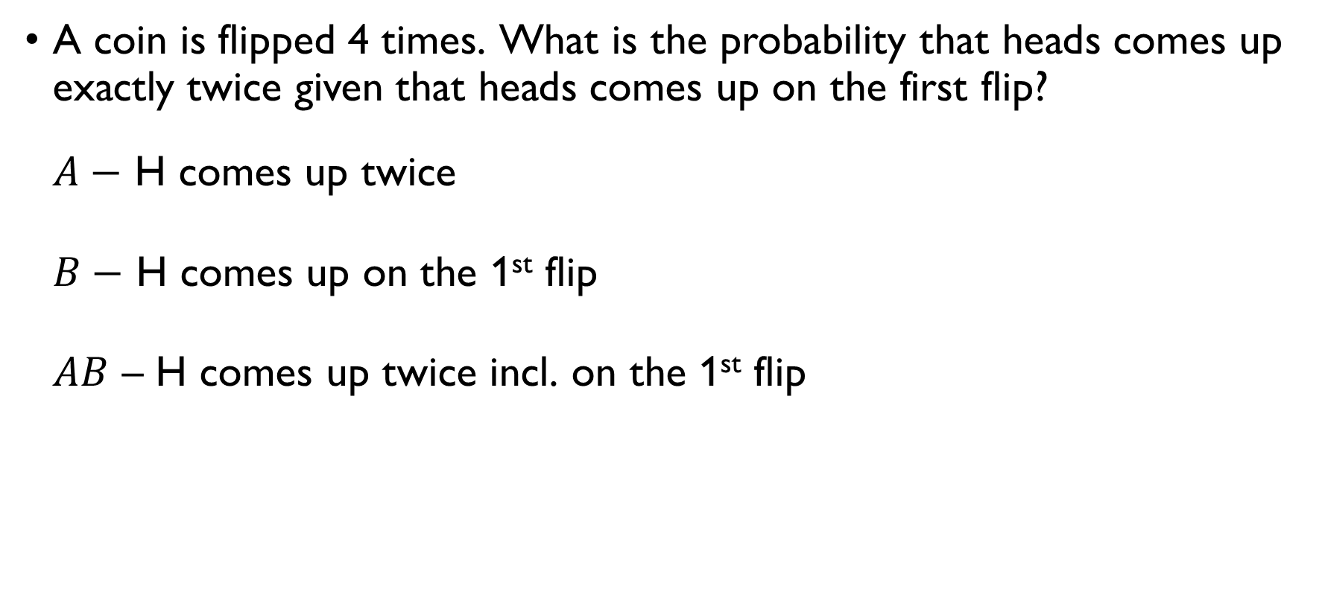
Flipping a coin 1
A coin is flipped 4 times. What is the probability that heads comes up exactly twice given that heads comes up on the first flip? $A−$ H comes up twice $P\left(A\right)=\frac{C\left(4,2\right)}{2^{4}}=\frac{3}{8}$ $B−$ H comes up on the 1st flip $P\left(B\right)=\frac{2^{3}}{2^{4}}=\frac{1}{2}$ $AB$ – H comes up twice incl. on the 1st flip $P\left(AB\right)=\frac{C\left(3, 2\right)}{2^{4}}=\frac{3}{16}$ $P\left(A|B\right)=\frac{3⋅8}{16⋅3}=\frac{1}{2}$

Slide 52
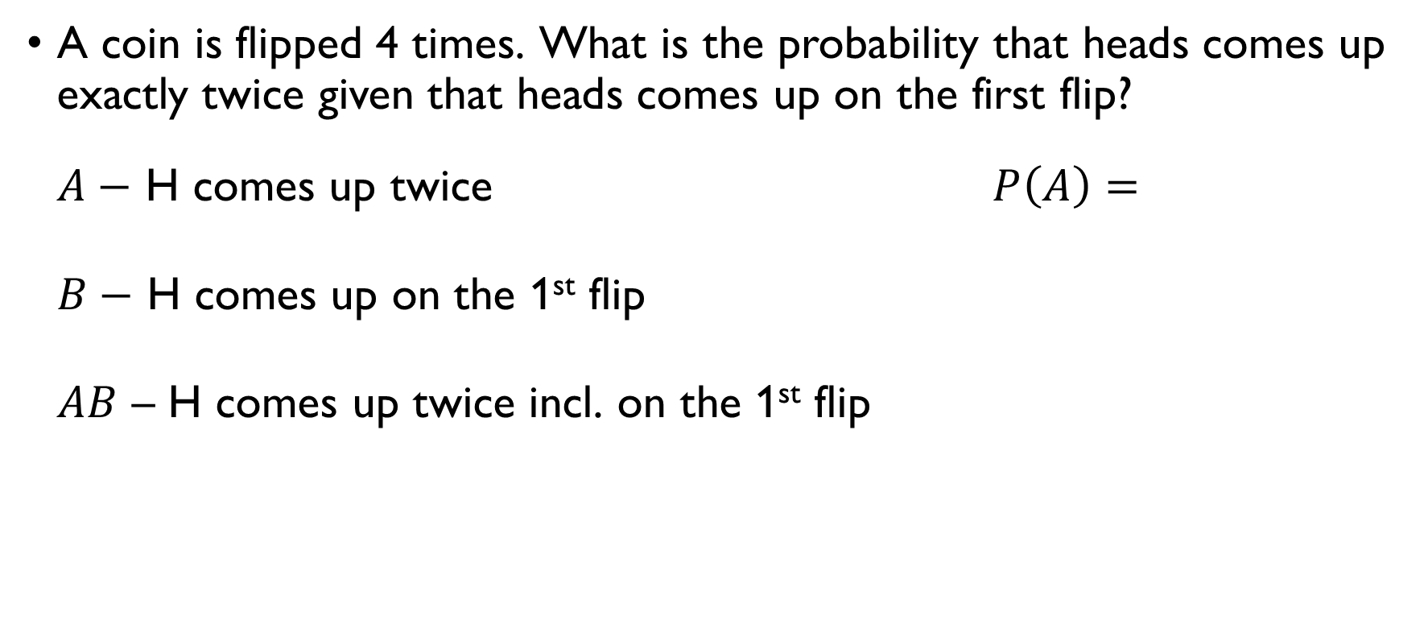
Flipping a coin 1
A coin is flipped 4 times. What is the probability that heads comes up exactly twice given that heads comes up on the first flip? $A−$ H comes up twice $P\left(A\right)=\frac{C\left(4,2\right)}{2^{4}}=\frac{3}{8}$ $B−$ H comes up on the 1st flip $P\left(B\right)=\frac{2^{3}}{2^{4}}=\frac{1}{2}$ $AB$ – H comes up twice incl. on the 1st flip $P\left(AB\right)=\frac{C\left(3, 2\right)}{2^{4}}=\frac{3}{16}$ $P\left(A|B\right)=\frac{3⋅8}{16⋅3}=\frac{1}{2}$

Slide 53
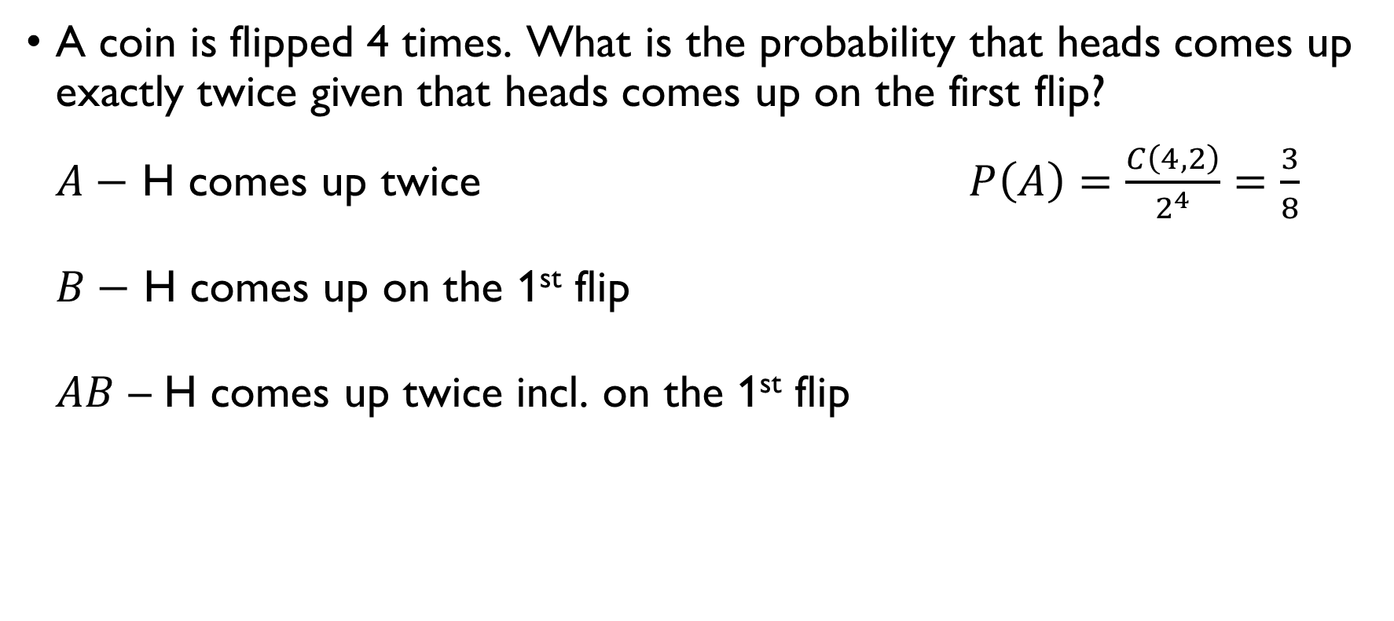
Flipping a coin 1
A coin is flipped 4 times. What is the probability that heads comes up exactly twice given that heads comes up on the first flip? $A−$ H comes up twice $P\left(A\right)=\frac{C\left(4,2\right)}{2^{4}}=\frac{3}{8}$ $B−$ H comes up on the 1st flip $P\left(B\right)=\frac{2^{3}}{2^{4}}=\frac{1}{2}$ $AB$ – H comes up twice incl. on the 1st flip $P\left(AB\right)=\frac{C\left(3, 2\right)}{2^{4}}=\frac{3}{16}$ $P\left(A|B\right)=\frac{3⋅8}{16⋅3}=\frac{1}{2}$

Slide 54
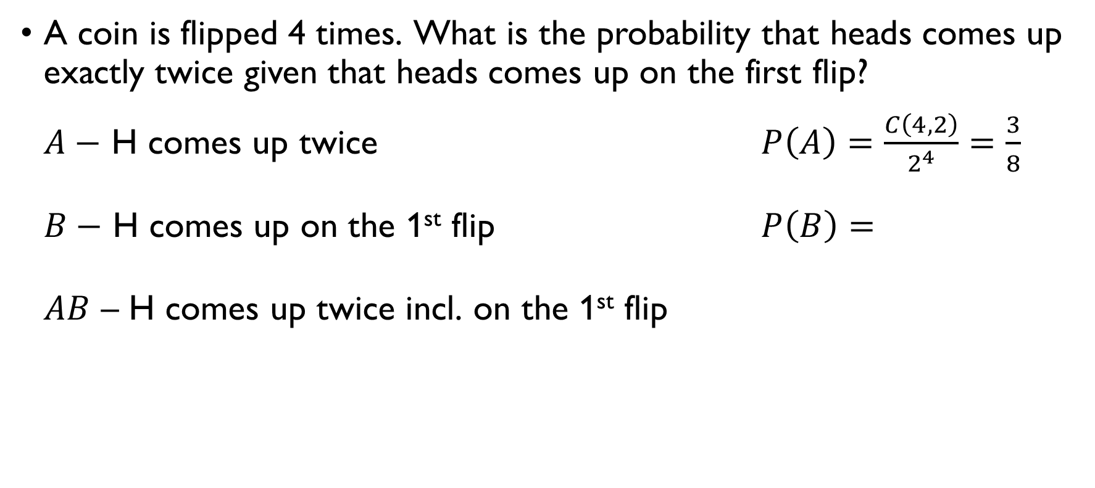
Flipping a coin 1
A coin is flipped 4 times. What is the probability that heads comes up exactly twice given that heads comes up on the first flip? $A−$ H comes up twice $P\left(A\right)=\frac{C\left(4,2\right)}{2^{4}}=\frac{3}{8}$ $B−$ H comes up on the 1st flip $P\left(B\right)=\frac{2^{3}}{2^{4}}=\frac{1}{2}$ $AB$ – H comes up twice incl. on the 1st flip $P\left(AB\right)=\frac{C\left(3, 2\right)}{2^{4}}=\frac{3}{16}$ $P\left(A|B\right)=\frac{3⋅8}{16⋅3}=\frac{1}{2}$

Slide 55
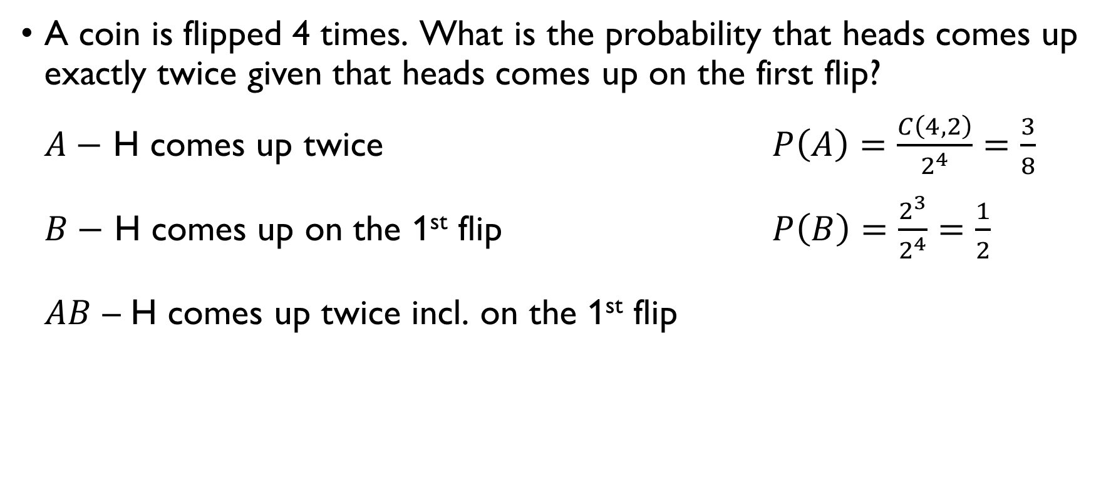
Flipping a coin 1
A coin is flipped 4 times. What is the probability that heads comes up exactly twice given that heads comes up on the first flip? $A−$ H comes up twice $P\left(A\right)=\frac{C\left(4,2\right)}{2^{4}}=\frac{3}{8}$ $B−$ H comes up on the 1st flip $P\left(B\right)=\frac{2^{3}}{2^{4}}=\frac{1}{2}$ $AB$ – H comes up twice incl. on the 1st flip $P\left(AB\right)=\frac{C\left(3, 2\right)}{2^{4}}=\frac{3}{16}$ $P\left(A|B\right)=\frac{3⋅8}{16⋅3}=\frac{1}{2}$

Slide 56
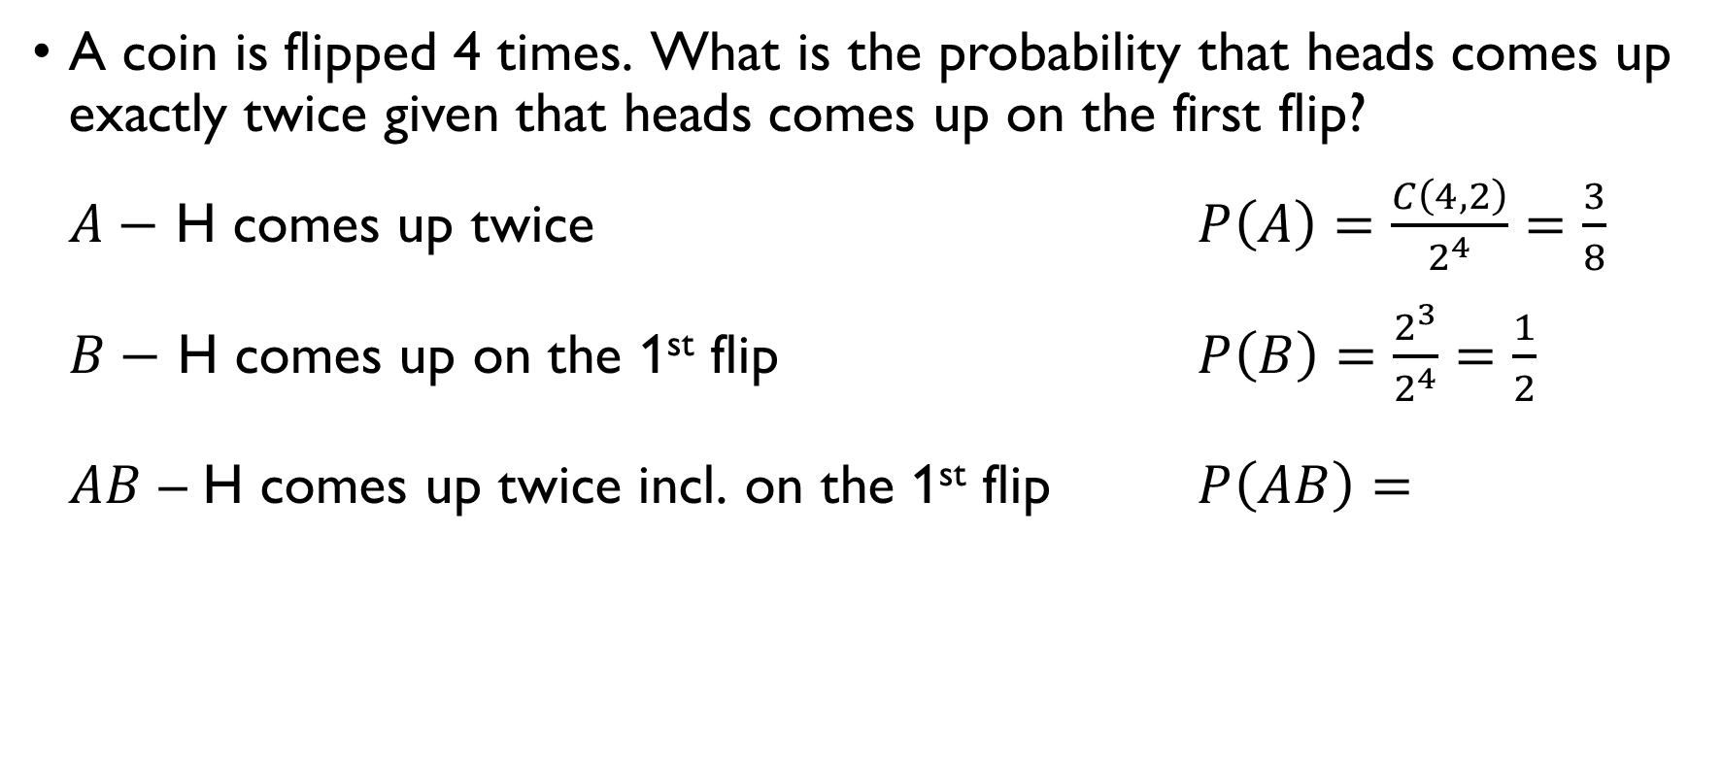
Flipping a coin 1
A coin is flipped 4 times. What is the probability that heads comes up exactly twice given that heads comes up on the first flip? $A−$ H comes up twice $P\left(A\right)=\frac{C\left(4,2\right)}{2^{4}}=\frac{3}{8}$ $B−$ H comes up on the 1st flip $P\left(B\right)=\frac{2^{3}}{2^{4}}=\frac{1}{2}$ $AB$ – H comes up twice incl. on the 1st flip $P\left(AB\right)=\frac{C\left(3, 2\right)}{2^{4}}=\frac{3}{16}$ $P\left(A|B\right)=\frac{3⋅8}{16⋅3}=\frac{1}{2}$

Slide 57
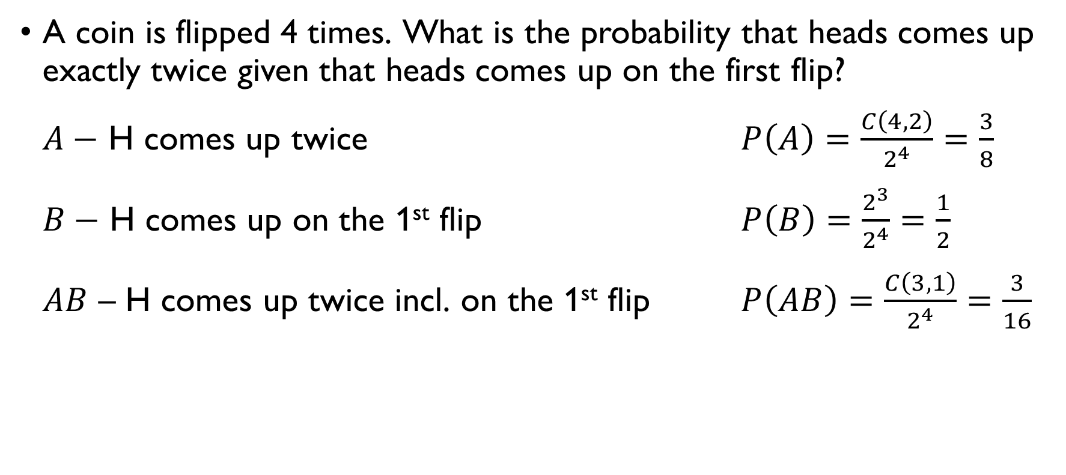
Flipping a coin 1
A coin is flipped 4 times. What is the probability that heads comes up exactly twice given that heads comes up on the first flip? $A−$ H comes up twice $P\left(A\right)=\frac{C\left(4,2\right)}{2^{4}}=\frac{3}{8}$ $B−$ H comes up on the 1st flip $P\left(B\right)=\frac{2^{3}}{2^{4}}=\frac{1}{2}$ $AB$ – H comes up twice incl. on the 1st flip $P\left(AB\right)=\frac{C\left(3, 1\right)}{2^{4}}=\frac{3}{16}$ $P\left(A|B\right)=\frac{3⋅8}{16⋅3}=\frac{1}{2}$

Slide 58
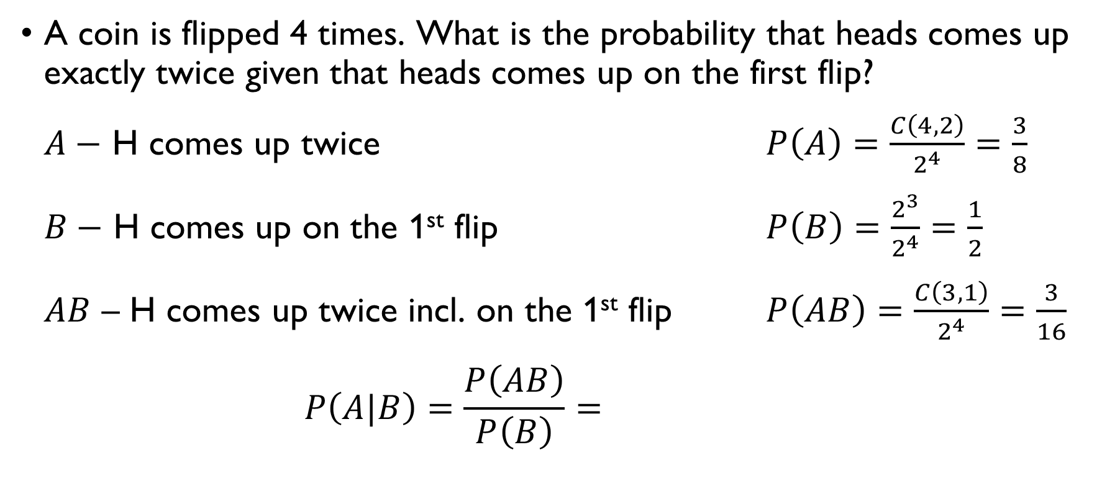
Flipping a coin 1
A coin is flipped 4 times. What is the probability that heads comes up exactly twice given that heads comes up on the first flip? $A−$ H comes up twice $P\left(A\right)=\frac{C\left(4,2\right)}{2^{4}}=\frac{3}{8}$ $B−$ H comes up on the 1st flip $P\left(B\right)=\frac{2^{3}}{2^{4}}=\frac{1}{2}$ $AB$ – H comes up twice incl. on the 1st flip $P\left(AB\right)=\frac{C\left(3, 1\right)}{2^{4}}=\frac{3}{16}$ $P\left(A|B\right)=\frac{P\left(AB\right)}{P\left(B\right)}=\frac{3⋅8}{16⋅3}=\frac{1}{2}$

Slide 59
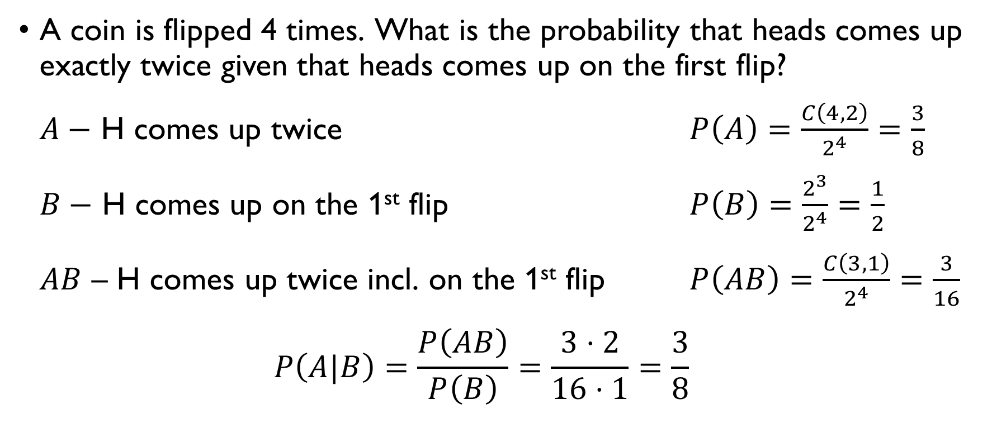
Flipping a coin 1
A coin is flipped 4 times. What is the probability that heads comes up exactly twice given that heads comes up on the first flip? $A−$ H comes up twice $P\left(A\right)=\frac{C\left(4,2\right)}{2^{4}}=\frac{3}{8}$ $B−$ H comes up on the 1st flip $P\left(B\right)=\frac{2^{3}}{2^{4}}=\frac{1}{2}$ $AB$ – H comes up twice incl. on the 1st flip $P\left(AB\right)=\frac{C\left(3, 1\right)}{2^{4}}=\frac{3}{16}$ $P\left(A|B\right)=\frac{P\left(AB\right)}{P\left(B\right)}=\frac{3⋅2}{16⋅1}=\frac{3}{8}$

Slide 60
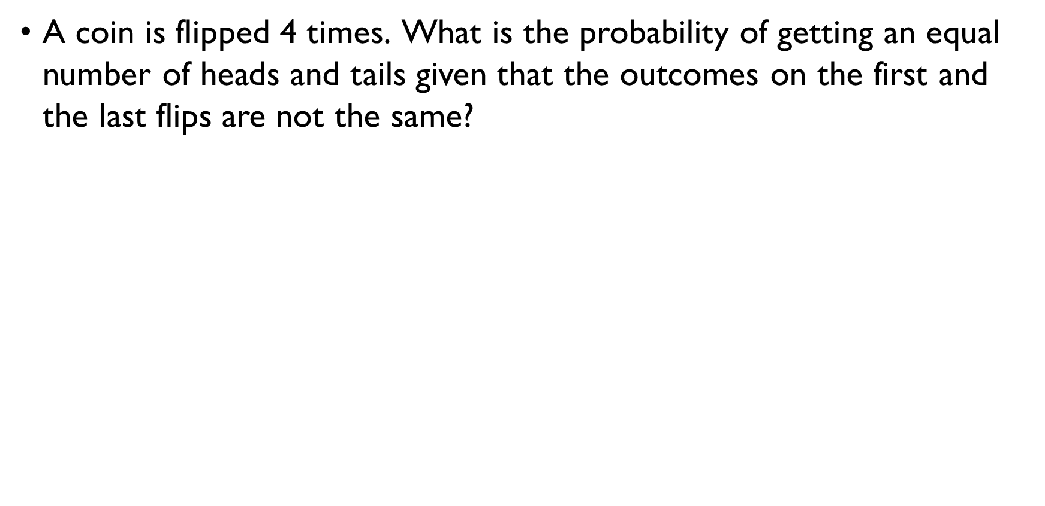
Flipping a coin 2
A coin is flipped 4 times. What is the probability of getting an equal number of heads and tails given that the outcomes on the first and the last flips are not the same? $A−$ equal number of H and T $B−$different results on the first and last flips $P\left(B\right)=\frac{2^{3}}{2^{4}}=\frac{1}{4}$ $AB−$ different results on the first and last flips $P\left(AB\right)=\frac{2}{2^{4}}=\frac{1}{8}$ equal number of H and T
$$P\left(A|B\right)=\frac{P\left(AB\right)}{P\left(B\right)}=\frac{1}{2}$$

Slide 61

Flipping a coin 2
A coin is flipped 4 times. What is the probability of getting an equal number of heads and tails given that the outcomes on the first and the last flips are not the same? $A−$ equal number of H and T $B−$different results on the first and last flips $P\left(B\right)=\frac{2^{3}}{2^{4}}=\frac{1}{4}$ $AB−$ different results on the first and last flips $P\left(AB\right)=\frac{2}{2^{4}}=\frac{1}{8}$ equal number of H and T
$$P\left(A|B\right)=\frac{P\left(AB\right)}{P\left(B\right)}=\frac{1}{2}$$

Slide 62

Flipping a coin 2
A coin is flipped 4 times. What is the probability of getting an equal number of heads and tails given that the outcomes on the first and the last flips are not the same? $A−$ equal number of H and T $B−$different results on the first and last flips $P\left(B\right)=\frac{2^{3}}{2^{4}}=\frac{1}{4}$ $AB−$ different results on the first and last flips $P\left(AB\right)=\frac{2}{2^{4}}=\frac{1}{8}$ equal number of H and T
$$P\left(A|B\right)=\frac{P\left(AB\right)}{P\left(B\right)}=\frac{1}{2}$$

Slide 63

Flipping a coin 2
A coin is flipped 4 times. What is the probability of getting an equal number of heads and tails given that the outcomes on the first and the last flips are not the same? $A−$ equal number of H and T $B−$different results on the first and last flips $P\left(B\right)=\frac{2^{3}}{2^{4}}=\frac{1}{4}$ $AB−$ different results on the first and last flips $P\left(AB\right)=\frac{2}{2^{4}}=\frac{1}{8}$ equal number of H and T
$$P\left(A|B\right)=\frac{P\left(AB\right)}{P\left(B\right)}=\frac{1}{2}$$

Slide 64

Flipping a coin 2
A coin is flipped 4 times. What is the probability of getting an equal number of heads and tails given that the outcomes on the first and the last flips are not the same? $A−$ equal number of H and T $B−$different results on the first and last flips $P\left(B\right)=\frac{2^{3}}{2^{4}}=\frac{1}{2}$ $AB−$ different results on the first and last flips $P\left(AB\right)=\frac{2}{2^{4}}=\frac{1}{8}$ equal number of H and T
$$P\left(A|B\right)=\frac{P\left(AB\right)}{P\left(B\right)}=\frac{1}{2}$$

Slide 65

Flipping a coin 2
A coin is flipped 4 times. What is the probability of getting an equal number of heads and tails given that the outcomes on the first and the last flips are not the same? $A−$ equal number of H and T $B−$different results on the first and last flips $P\left(B\right)=\frac{2^{3}}{2^{4}}=\frac{1}{2}$ $AB−$ different results on the first and last flips $P\left(AB\right)=\frac{2}{2^{4}}=\frac{1}{8}$ equal number of H and T
$$P\left(A|B\right)=\frac{P\left(AB\right)}{P\left(B\right)}=\frac{1}{2}$$

Slide 66

Flipping a coin 2
A coin is flipped 4 times. What is the probability of getting an equal number of heads and tails given that the outcomes on the first and the last flips are not the same? $A−$ equal number of H and T $B−$different results on the first and last flips $P\left(B\right)=\frac{2^{3}}{2^{4}}=\frac{1}{2}$ $AB−$ different results on the first and last flips $P\left(AB\right)=\frac{2^{2}}{2^{4}}=\frac{1}{4}$ equal number of H and T
$$P\left(A|B\right)=\frac{P\left(AB\right)}{P\left(B\right)}=\frac{1}{2}$$

Slide 67

Flipping a coin 2
A coin is flipped 4 times. What is the probability of getting an equal number of heads and tails given that the outcomes on the first and the last flips are not the same? $A−$ equal number of H and T $B−$different results on the first and last flips $P\left(B\right)=\frac{2^{3}}{2^{4}}=\frac{1}{2}$ $AB−$ different results on the first and last flips $P\left(AB\right)=\frac{2^{2}}{2^{4}}=\frac{1}{4}$ equal number of H and T
$$P\left(A|B\right)=\frac{P\left(AB\right)}{P\left(B\right)}=\frac{1}{2}$$

Slide 68

Flipping a coin 2
A coin is flipped 4 times. What is the probability of getting an equal number of heads and tails given that the outcomes on the first and the last flips are not the same? $A−$ equal number of H and T $B−$different results on the first and last flips $P\left(B\right)=\frac{2^{3}}{2^{4}}=\frac{1}{4}$ $AB−$ different results on the first and last flips $P\left(AB\right)=\frac{2}{2^{4}}=\frac{1}{8}$ equal number of H and T
$$P\left(A|B\right)=\frac{P\left(AB\right)}{P\left(B\right)}=\frac{1}{2}$$

Slide 69

Rolling a die
We roll two fair dice. What is the probability to have 2 on the first die given that the sum of two numbers is 5?
$$P\left(X_{1}=2|X_{1}+X_{2}=5\right)=\frac{P\left(X_{1}=2, X_{1}+X_{2}=5\right)}{P\left(X_{1}+X_{2}=5\right)}=\frac{1}{4}$$
$$P\left(X_{1}=2 and X_{1}+X_{2}=5\right)=P\left(X_{1}=2 and X_{2}=3\right)=\frac{1}{6⋅6}$$
$$P\left(X_{1}+X_{2}=5\right)=\frac{4}{36}=\frac{1}{9}$$

Slide 70

Rolling a die
We roll two fair dice. What is the probability to have 2 on the first die given that the sum of two numbers is 5?
$$P\left(X_{1}=2|X_{1}+X_{2}=5\right)=\frac{P\left(X_{1}=2, X_{1}+X_{2}=5\right)}{P\left(X_{1}+X_{2}=5\right)}=\frac{1}{4}$$
$$P\left(X_{1}=2 and X_{1}+X_{2}=5\right)=P\left(X_{1}=2 and X_{2}=3\right)=\frac{1}{6⋅6}$$
$$P\left(X_{1}+X_{2}=5\right)=\frac{4}{36}=\frac{1}{9}$$

Slide 71

Rolling a die
We roll two fair dice. What is the probability to have 2 on the first die given that the sum of two numbers is 5?
$$P\left(X_{1}=2|X_{1}+X_{2}=5\right)=\frac{P\left(X_{1}=2, X_{1}+X_{2}=5\right)}{P\left(X_{1}+X_{2}=5\right)}=\frac{1}{4}$$
$$P\left(X_{1}=2 and X_{1}+X_{2}=5\right)=P\left(X_{1}=2 and X_{2}=3\right)=\frac{1}{6⋅6}$$
$$P\left(X_{1}+X_{2}=5\right)=\frac{4}{36}=\frac{1}{9}$$

Slide 72

Rolling a die
We roll two fair dice. What is the probability to have 2 on the first die given that the sum of two numbers is 5?
$$P\left(X_{1}=2|X_{1}+X_{2}=5\right)=\frac{P\left(X_{1}=2, X_{1}+X_{2}=5\right)}{P\left(X_{1}+X_{2}=5\right)}=\frac{1}{4}$$
$$P\left(X_{1}=2 and X_{1}+X_{2}=5\right)=P\left(X_{1}=2 and X_{2}=3\right)=\frac{1}{6⋅6}$$
$$P\left(X_{1}+X_{2}=5\right)=\frac{4}{36}=\frac{1}{9}$$

Slide 73

Rolling a die
We roll two fair dice. What is the probability to have 2 on the first die given that the sum of two numbers is 5?
$$P\left(X_{1}=2|X_{1}+X_{2}=5\right)=\frac{P\left(X_{1}=2, X_{1}+X_{2}=5\right)}{P\left(X_{1}+X_{2}=5\right)}=\frac{1}{4}$$
$$P\left(X_{1}=2 and X_{1}+X_{2}=5\right)=P\left(X_{1}=2 and X_{2}=3\right)=\frac{1}{6⋅6}$$
$$P\left(X_{1}+X_{2}=5\right)=\frac{4}{36}=\frac{1}{9}$$

Slide 74

Rolling a die
We roll two fair dice. What is the probability to have 2 on the first die given that the sum of two numbers is 5?
$$P\left(X_{1}=2|X_{1}+X_{2}=5\right)=\frac{P\left(X_{1}=2, X_{1}+X_{2}=5\right)}{P\left(X_{1}+X_{2}=5\right)}=\frac{1}{4}$$
$$P\left(X_{1}=2 and X_{1}+X_{2}=5\right)=P\left(X_{1}=2 and X_{2}=3\right)=\frac{1}{6⋅6}$$
$$P\left(X_{1}+X_{2}=5\right)=\frac{4}{36}=\frac{1}{9}$$

Slide 75

Rolling a die
We roll two fair dice. What is the probability to have 2 on the first die given that the sum of two numbers is 5?
$$P\left(X_{1}=2|X_{1}+X_{2}=5\right)=\frac{P\left(X_{1}=2, X_{1}+X_{2}=5\right)}{P\left(X_{1}+X_{2}=5\right)}=\frac{1}{4}$$
$$P\left(X_{1}=2 and X_{1}+X_{2}=5\right)=P\left(X_{1}=2 and X_{2}=3\right)=\frac{1}{6⋅6}$$
$$P\left(X_{1}+X_{2}=5\right)=\frac{4}{36}=\frac{1}{9}$$

Slide 76

Rolling a die
We roll two fair dice. What is the probability to have 2 on the first die given that the sum of two numbers is 5?
$$P\left(X_{1}=2|X_{1}+X_{2}=5\right)=\frac{P\left(X_{1}=2, X_{1}+X_{2}=5\right)}{P\left(X_{1}+X_{2}=5\right)}=\frac{1}{4}$$
$$P\left(X_{1}=2 and X_{1}+X_{2}=5\right)=P\left(X_{1}=2 and X_{2}=3\right)=\frac{1}{6⋅6}$$
$$P\left(X_{1}+X_{2}=5\right)=\frac{4}{36}=\frac{1}{9}$$

Slide 77

Rolling a die
We roll two fair dice. What is the probability to have 2 on the first die given that the sum of two numbers is 5?
$$P\left(X_{1}=2|X_{1}+X_{2}=5\right)=\frac{P\left(X_{1}=2, X_{1}+X_{2}=5\right)}{P\left(X_{1}+X_{2}=5\right)}=\frac{1}{4}$$
$$P\left(X_{1}=2 and X_{1}+X_{2}=5\right)=P\left(X_{1}=2 and X_{2}=3\right)=\frac{1}{6⋅6}$$
$$P\left(X_{1}+X_{2}=5\right)=\frac{4}{36}=\frac{1}{9}$$

Slide 78
The law of total probability
https://youtu.be/U3_783xznQI

Slide 79




The law of total probability
Suppose that the sample space $S$ is split into $n$ disjoint events:
$$S=E_{1}∪E_{2}∪…∪E_{n}, E_{1}∩E_{2}∩…∩E_{n}=∅$$
Then $P\left(A\right)$ can be computed as follows:
$$P\left(A\right)=P\left(A,E_{1}\right)+P\left(A,E_{2}\right)+…+P\left(A,E_{n}\right)=$$
$$=P\left(A|E_{1}\right)⋅P\left(E_{1}\right)+P\left(A|E_{2}\right)⋅P\left(E_{2}\right)+$$
$$+…+P\left(A|E_{n}\right)⋅P\left(E_{n}\right)$$
$$E_{1}$$
$$E_{2}$$
$$E_{3}$$

Slide 80




The law of total probability
Suppose that the sample space $S$ is split into $n$ disjoint events:
$$S=E_{1}∪E_{2}∪…∪E_{n}, E_{1}∩E_{2}∩…∩E_{n}=∅$$
Then $P\left(A\right)$ can be computed as follows:
$$P\left(A\right)=P\left(A,E_{1}\right)+P\left(A,E_{2}\right)+…+P\left(A,E_{n}\right)=$$
$$=P\left(A|E_{1}\right)⋅P\left(E_{1}\right)+P\left(A|E_{2}\right)⋅P\left(E_{2}\right)+$$
$$+…+P\left(A|E_{n}\right)⋅P\left(E_{n}\right)$$
$$E_{1}$$
$$E_{2}$$
$$E_{3}$$
$$A∩E_{1}$$
$$A∩E_{2}$$
$$A∩E_{3}$$

Slide 81

heights
In a class, 40% of students are male and 60% are female. It’s known that 60% of the males and 10% of the females are taller than 6 feet. What % of the class is not taller than 6 feet?
$$P\left(≤6\right)=P\left(≤6 and Male\right)+P\left(≤6 and Female\right)=$$
$$=P\left(≤6|M\right)⋅P\left(M\right)+P\left(≤6|F\right)⋅P\left(F\right)=$$
$$=\left(1−0.6\right)⋅0.4+\left(1−0.1\right)⋅0.6=0.7$$

Slide 82

heights
In a class, 40% of students are male and 60% are female. It’s known that 60% of the males and 10% of the females are taller than 6 feet. What % of the class is not taller than 6 feet?
$$P\left(≤6\right)=P\left(≤6 and Male\right)+P\left(≤6 and Female\right)=$$
$$=P\left(≤6|M\right)⋅P\left(M\right)+P\left(≤6|F\right)⋅P\left(F\right)=$$
$$=\left(1−0.6\right)⋅0.4+\left(1−0.1\right)⋅0.6=0.7$$

Slide 83

heights
In a class, 40% of students are male and 60% are female. It’s known that 60% of the males and 10% of the females are taller than 6 feet. What % of the class is not taller than 6 feet?
$$P\left(≤6\right)=P\left(≤6 and Male\right)+P\left(≤6 and Female\right)=$$
$$=P\left(≤6|M\right)⋅P\left(M\right)+P\left(≤6|F\right)⋅P\left(F\right)=$$
$$=\left(1−0.6\right)⋅0.4+\left(1−0.1\right)⋅0.6=0.7$$

Slide 84

heights
In a class, 40% of students are male and 60% are female. It’s known that 60% of the males and 10% of the females are taller than 6 feet. What % of the class is not taller than 6 feet?
$$P\left(≤6\right)=P\left(≤6 and Male\right)+P\left(≤6 and Female\right)=$$
$$=P\left(≤6|M\right)⋅P\left(M\right)+P\left(≤6|F\right)⋅P\left(F\right)=$$
$$=\left(1−0.6\right)⋅0.4+\left(1−0.1\right)⋅0.6=0.7$$

Slide 85

heights
In a class, 40% of students are male and 60% are female. It’s known that 60% of the males and 10% of the females are taller than 6 feet. What % of the class is not taller than 6 feet?
$$P\left(≤6\right)=P\left(≤6 and Male\right)+P\left(≤6 and Female\right)=$$
$$=P\left(≤6|M\right)⋅P\left(M\right)+P\left(≤6|F\right)⋅P\left(F\right)=$$
$$=\left(1−0.6\right)⋅0.4+\left(1−0.1\right)⋅0.6=0.7$$

Slide 86

coins
A box contains 3 coins with a head on each side, 4 coins with a tail on each side, and 2 fair coins. One of these nine coins is selected at random and tossed once. What is the probability that a head will be obtained?
$E_{H}−$ a coin with 2 H is selected $P\left(E_{H}\right)=\frac{3}{3+4+2}=\frac{1}{3}$
$E_{T}−$ a coin with 2 T is selected $P\left(E_{T}\right)=\frac{4}{3+4+2}=\frac{4}{9}$
$E_{F}−$ a fair coin is selected $P\left(E_{H}\right)=\frac{2}{3+4+2}=\frac{2}{9}$
$$P\left(H\right)=P\left(H|E_{H}\right)⋅P\left(E_{H}\right)+P\left(H|E_{T}\right)⋅P\left(E_{T}\right)+P\left(H|E_{F}\right)⋅P\left(E_{F}\right)=$$
$$=1⋅\frac{1}{3}+0+\frac{1}{2}⋅\frac{2}{9}=\frac{1}{3}+\frac{1}{9}=\frac{4}{9}$$

Slide 87

coins
A box contains 3 coins with a head on each side, 4 coins with a tail on each side, and 2 fair coins. One of these nine coins is selected at random and tossed once. What is the probability that a head will be obtained?
$E_{H}−$ a coin with 2 H is selected $P\left(E_{H}\right)=\frac{3}{3+4+2}=\frac{1}{3}$
$E_{T}−$ a coin with 2 T is selected $P\left(E_{T}\right)=\frac{4}{3+4+2}=\frac{4}{9}$
$E_{F}−$ a fair coin is selected $P\left(E_{H}\right)=\frac{2}{3+4+2}=\frac{2}{9}$
$$P\left(H\right)=P\left(H|E_{H}\right)⋅P\left(E_{H}\right)+P\left(H|E_{T}\right)⋅P\left(E_{T}\right)+P\left(H|E_{F}\right)⋅P\left(E_{F}\right)=$$
$$=1⋅\frac{1}{3}+0+\frac{1}{2}⋅\frac{2}{9}=\frac{1}{3}+\frac{1}{9}=\frac{4}{9}$$

Slide 88

coins
A box contains 3 coins with a head on each side, 4 coins with a tail on each side, and 2 fair coins. One of these nine coins is selected at random and tossed once. What is the probability that a head will be obtained?
$E_{H}−$ a coin with 2 H is selected $P\left(E_{H}\right)=\frac{3}{3+4+2}=\frac{1}{3}$
$E_{T}−$ a coin with 2 T is selected $P\left(E_{T}\right)=\frac{4}{3+4+2}=\frac{4}{9}$
$E_{F}−$ a fair coin is selected $P\left(E_{H}\right)=\frac{2}{3+4+2}=\frac{2}{9}$
$$P\left(H\right)=P\left(H|E_{H}\right)⋅P\left(E_{H}\right)+P\left(H|E_{T}\right)⋅P\left(E_{T}\right)+P\left(H|E_{F}\right)⋅P\left(E_{F}\right)=$$
$$=1⋅\frac{1}{3}+0+\frac{1}{2}⋅\frac{2}{9}=\frac{1}{3}+\frac{1}{9}=\frac{4}{9}$$

Slide 89
coins
A box contains 3 coins with a head on each side, 4 coins with a tail on each side, and 2 fair coins. One of these nine coins is selected at random and tossed once. What is the probability that a head will be obtained?
$E_{H}−$ a coin with 2 H is selected $P\left(E_{H}\right)=\frac{3}{3+4+2}=\frac{1}{3}$
$E_{T}−$ a coin with 2 T is selected $P\left(E_{T}\right)=\frac{4}{3+4+2}=\frac{4}{9}$
$E_{F}−$ a fair coin is selected $P\left(E_{H}\right)=\frac{2}{3+4+2}=\frac{2}{9}$
$$P\left(H\right)=P\left(H|E_{H}\right)⋅P\left(E_{H}\right)+P\left(H|E_{T}\right)⋅P\left(E_{T}\right)+P\left(H|E_{F}\right)⋅P\left(E_{F}\right)=$$
$$=1⋅\frac{1}{3}+0+\frac{1}{2}⋅\frac{2}{9}=\frac{1}{3}+\frac{1}{9}=\frac{4}{9}$$

Slide 90

coins
A box contains 3 coins with a head on each side, 4 coins with a tail on each side, and 2 fair coins. One of these nine coins is selected at random and tossed once. What is the probability that a head will be obtained?
$E_{H}−$ a coin with 2 H is selected $P\left(E_{H}\right)=\frac{3}{3+4+2}=\frac{1}{3}$
$E_{T}−$ a coin with 2 T is selected $P\left(E_{T}\right)=\frac{4}{3+4+2}=\frac{4}{9}$
$E_{F}−$ a fair coin is selected $P\left(E_{H}\right)=\frac{2}{3+4+2}=\frac{2}{9}$
$$P\left(H\right)=P\left(H|E_{H}\right)⋅P\left(E_{H}\right)+P\left(H|E_{T}\right)⋅P\left(E_{T}\right)+P\left(H|E_{F}\right)⋅P\left(E_{F}\right)=$$
$$=1⋅\frac{1}{3}+0+\frac{1}{2}⋅\frac{2}{9}=\frac{1}{3}+\frac{1}{9}=\frac{4}{9}$$

Slide 91

coins
A box contains 3 coins with a head on each side, 4 coins with a tail on each side, and 2 fair coins. One of these nine coins is selected at random and tossed once. What is the probability that a head will be obtained?
$E_{H}−$ a coin with 2 H is selected $P\left(E_{H}\right)=\frac{3}{3+4+2}=\frac{1}{3}$
$E_{T}−$ a coin with 2 T is selected $P\left(E_{T}\right)=\frac{4}{3+4+2}=\frac{4}{9}$
$E_{F}−$ a fair coin is selected $P\left(E_{H}\right)=\frac{2}{3+4+2}=\frac{2}{9}$
$$P\left(H\right)=P\left(H|E_{H}\right)⋅P\left(E_{H}\right)+P\left(H|E_{T}\right)⋅P\left(E_{T}\right)+P\left(H|E_{F}\right)⋅P\left(E_{F}\right)=$$
$$=1⋅\frac{1}{3}+0+\frac{1}{2}⋅\frac{2}{9}=\frac{1}{3}+\frac{1}{9}=\frac{4}{9}$$

Slide 92

coins
A box contains 3 coins with a head on each side, 4 coins with a tail on each side, and 2 fair coins. One of these nine coins is selected at random and tossed once. What is the probability that a head will be obtained?
$E_{H}−$ a coin with 2 H is selected $P\left(E_{H}\right)=\frac{3}{3+4+2}=\frac{1}{3}$
$E_{T}−$ a coin with 2 T is selected $P\left(E_{T}\right)=\frac{4}{3+4+2}=\frac{4}{9}$
$E_{F}−$ a fair coin is selected $P\left(E_{H}\right)=\frac{2}{3+4+2}=\frac{2}{9}$
$$P\left(H\right)=P\left(H|E_{H}\right)⋅P\left(E_{H}\right)+P\left(H|E_{T}\right)⋅P\left(E_{T}\right)+P\left(H|E_{F}\right)⋅P\left(E_{F}\right)=$$
$$=1⋅\frac{1}{3}+0+\frac{1}{2}⋅\frac{2}{9}=\frac{1}{3}+\frac{1}{9}=\frac{4}{9}$$

Slide 93

coins
A box contains 3 coins with a head on each side, 4 coins with a tail on each side, and 2 fair coins. One of these nine coins is selected at random and tossed once. What is the probability that a head will be obtained?
$E_{H}−$ a coin with 2 H is selected $P\left(E_{H}\right)=\frac{3}{3+4+2}=\frac{1}{3}$
$E_{T}−$ a coin with 2 T is selected $P\left(E_{T}\right)=\frac{4}{3+4+2}=\frac{4}{9}$
$E_{F}−$ a fair coin is selected $P\left(E_{H}\right)=\frac{2}{3+4+2}=\frac{2}{9}$
$$P\left(H\right)=P\left(H|E_{H}\right)⋅P\left(E_{H}\right)+P\left(H|E_{T}\right)⋅P\left(E_{T}\right)+P\left(H|E_{F}\right)⋅P\left(E_{F}\right)=$$
$$=1⋅\frac{1}{3}+0+\frac{1}{2}⋅\frac{2}{9}=\frac{1}{3}+\frac{1}{9}=\frac{4}{9}$$

Slide 94

coins
A box contains 3 coins with a head on each side, 4 coins with a tail on each side, and 2 fair coins. One of these nine coins is selected at random and tossed once. What is the probability that a head will be obtained?
$E_{H}−$ a coin with 2 H is selected $P\left(E_{H}\right)=\frac{3}{3+4+2}=\frac{1}{3}$
$E_{T}−$ a coin with 2 T is selected $P\left(E_{T}\right)=\frac{4}{3+4+2}=\frac{4}{9}$
$E_{F}−$ a fair coin is selected $P\left(E_{H}\right)=\frac{2}{3+4+2}=\frac{2}{9}$
$$P\left(H\right)=P\left(H|E_{H}\right)⋅P\left(E_{H}\right)+P\left(H|E_{T}\right)⋅P\left(E_{T}\right)+P\left(H|E_{F}\right)⋅P\left(E_{F}\right)=$$
$$=1⋅\frac{1}{3}+0+\frac{1}{2}⋅\frac{2}{9}=\frac{1}{3}+\frac{1}{9}=\frac{4}{9}$$

Slide 95

coins
A box contains 3 coins with a head on each side, 4 coins with a tail on each side, and 2 fair coins. One of these nine coins is selected at random and tossed once. What is the probability that a head will be obtained?
$E_{H}−$ a coin with 2 H is selected $P\left(E_{H}\right)=\frac{3}{3+4+2}=\frac{1}{3}$
$E_{T}−$ a coin with 2 T is selected $P\left(E_{T}\right)=\frac{4}{3+4+2}=\frac{4}{9}$
$E_{F}−$ a fair coin is selected $P\left(E_{H}\right)=\frac{2}{3+4+2}=\frac{2}{9}$
$$P\left(H\right)=P\left(H|E_{H}\right)⋅P\left(E_{H}\right)+P\left(H|E_{T}\right)⋅P\left(E_{T}\right)+P\left(H|E_{F}\right)⋅P\left(E_{F}\right)=$$
$$=1⋅\frac{1}{3}+0+\frac{1}{2}⋅\frac{2}{9}=\frac{1}{3}+\frac{1}{9}=\frac{4}{9}$$

Slide 96

coins
A box contains 3 coins with a head on each side, 4 coins with a tail on each side, and 2 fair coins. One of these nine coins is selected at random and tossed once. What is the probability that a head will be obtained?
$E_{H}−$ a coin with 2 H is selected $P\left(E_{H}\right)=\frac{3}{3+4+2}=\frac{1}{3}$
$E_{T}−$ a coin with 2 T is selected $P\left(E_{T}\right)=\frac{4}{3+4+2}=\frac{4}{9}$
$E_{F}−$ a fair coin is selected $P\left(E_{H}\right)=\frac{2}{3+4+2}=\frac{2}{9}$
$$P\left(H\right)=P\left(H|E_{H}\right)⋅P\left(E_{H}\right)+P\left(H|E_{T}\right)⋅P\left(E_{T}\right)+P\left(H|E_{F}\right)⋅P\left(E_{F}\right)=$$
$$=1⋅\frac{1}{3}+0+\frac{1}{2}⋅\frac{2}{9}=\frac{1}{3}+\frac{1}{9}=\frac{4}{9}$$

Slide 97

coins
A box contains 3 coins with a head on each side, 4 coins with a tail on each side, and 2 fair coins. One of these nine coins is selected at random and tossed once. What is the probability that a head will be obtained?
$E_{H}−$ a coin with 2 H is selected $P\left(E_{H}\right)=\frac{3}{3+4+2}=\frac{1}{3}$
$E_{T}−$ a coin with 2 T is selected $P\left(E_{T}\right)=\frac{4}{3+4+2}=\frac{4}{9}$
$E_{F}−$ a fair coin is selected $P\left(E_{H}\right)=\frac{2}{3+4+2}=\frac{2}{9}$
$$P\left(H\right)=P\left(H|E_{H}\right)⋅P\left(E_{H}\right)+P\left(H|E_{T}\right)⋅P\left(E_{T}\right)+P\left(H|E_{F}\right)⋅P\left(E_{F}\right)=$$
$$=1⋅\frac{1}{3}+0+\frac{1}{2}⋅\frac{2}{9}=\frac{1}{3}+\frac{1}{9}=\frac{4}{9}$$

Slide 98
Bayes’ rule

Slide 99

A test for disease
Imagine that a rare disease affects 1% of the population
$$P\left(D\right)=0.01$$
A 90% - accurate test has been developed to detect the disease
$$P\left(+|D\right)=0.9, P\left(−|no D\right)=0.9$$
You test positive. How much should you be worried?
$$P\left(D |+\right)= ?$$

Slide 100

A test for disease
Imagine that a rare disease affects 1% of the population
$$P\left(D\right)=0.01$$
A 90% - accurate test has been developed to detect the disease
$$P\left(+|D\right)=0.9, P\left(−|no D\right)=0.9$$
You test positive. How much should you be worried?
$$P\left(D |+\right)= ?$$

Slide 101

A test for disease
Imagine that a rare disease affects 1% of the population
$$P\left(D\right)=0.01$$
A 90% - accurate test has been developed to detect the disease
$$P\left(+|D\right)=0.9, P\left(−|no D\right)=0.9$$
You test positive. How much should you be worried?
$$P\left(D |+\right)= ?$$

Slide 102

A test for disease
Imagine that a rare disease affects 1% of the population
$$P\left(D\right)=0.01$$
A 90% - accurate test has been developed to detect the disease
$$P\left(+|D\right)=0.9, P\left(−|no D\right)=0.9$$
You test positive. How much should you be worried?
$$P\left(D |+\right)= ?$$

Slide 103

A test for disease
Imagine that a rare disease affects 1% of the population
$$P\left(D\right)=0.01$$
A 90% - accurate test has been developed to detect the disease
$$P\left(+|D\right)=0.9, P\left(−|no D\right)=0.9$$
You test positive. How much should you be worried?
$$P\left(D |+\right)= ?$$

Slide 104

A test for disease
Imagine that a rare disease affects 1% of the population
$$P\left(D\right)=0.01$$
A 90% - accurate test has been developed to detect the disease
$$P\left(+|D\right)=0.9, P\left(−|no D\right)=0.9$$
You test positive. How much should you be worried?
$$P\left(D |+\right)= ?$$

Slide 105
Try it!

Slide 106

How reliable the test is?
$$P\left(D\right)=0.01, P\left(+ | D\right)=P\left(− | no D\right)=0.9$$
REALITY / TEST RESULTS | POSITIVE | NEGATIVE
HEALTHY | FALSE POSITIVES 10% of 99% healthy people = 9.9% of the population | TRUE NEGATIVES 90% of 99% healthy people = 89.1% of the population
ILL | TRUE POSITIVES 90% of 1% ill people = 0.9% of the population | FALSE NEGATIVES 10% of 1% ill people = 0.1% of the population

Slide 107
How reliable the test is?
$$P\left(D\right)=0.01, P\left(+ | D\right)=P\left(− | no D\right)=0.9$$
REALITY / TEST RESULTS | POSITIVE | NEGATIVE
HEALTHY | FALSE POSITIVES 10% of 99% healthy people = 9.9% of the population | TRUE NEGATIVES 90% of 99% healthy people = 89.1% of the population
ILL | TRUE POSITIVES 90% of 1% ill people = 0.9% of the population | FALSE NEGATIVES 10% of 1% ill people = 0.1% of the population

Slide 108
How reliable the test is?
$$P\left(D\right)=0.01, P\left(+ | D\right)=P\left(− | no D\right)=0.9$$
REALITY / TEST RESULTS | POSITIVE | NEGATIVE
HEALTHY | FALSE POSITIVES 10% of 99% healthy people = 9.9% of the population | TRUE NEGATIVES 90% of 99% healthy people = 89.1% of the population
ILL | TRUE POSITIVES 90% of 1% ill people = 0.9% of the population | FALSE NEGATIVES 10% of 1% ill people = 0.1% of the population

Slide 109

How reliable the test is?
$$P\left(D\right)=0.01, P\left(+ | D\right)=P\left(− | no D\right)=0.9$$
REALITY / TEST RESULTS | POSITIVE | NEGATIVE
HEALTHY | FALSE POSITIVES 10% of 99% healthy people = 9.9% of the population | TRUE NEGATIVES 90% of 99% healthy people = 89.1% of the population
ILL | TRUE POSITIVES 90% of 1% ill people = 0.9% of the population | FALSE NEGATIVES 10% of 1% ill people = 0.1% of the population

Slide 110
How reliable the test is?
$$P\left(D\right)=0.01, P\left(+ | D\right)=P\left(− | no D\right)=0.9$$
REALITY / TEST RESULTS | POSITIVE | NEGATIVE
HEALTHY | FALSE POSITIVES 10% of 99% healthy people = 9.9% of the population | TRUE NEGATIVES 90% of 99% healthy people = 89.1% of the population
ILL | TRUE POSITIVES 90% of 1% ill people = 0.9% of the population | FALSE NEGATIVES 10% of 1% ill people = 0.1% of the population

Slide 111
How reliable the test is?
$$P\left(D\right)=0.01, P\left(+ | D\right)=P\left(− | no D\right)=0.9$$
REALITY / TEST RESULTS | POSITIVE | NEGATIVE
HEALTHY | FALSE POSITIVES 10% of 99% healthy people = 9.9% of the population | TRUE NEGATIVES 90% of 99% healthy people = 89.1% of the population
ILL | TRUE POSITIVES 90% of 1% ill people = 0.9% of the population | FALSE NEGATIVES 10% of 1% ill people = 0.1% of the population

Slide 112
How reliable the test is?
$$P\left(D\right)=0.01, P\left(+ | D\right)=P\left(− | no D\right)=0.9$$
REALITY / TEST RESULTS | POSITIVE | NEGATIVE
HEALTHY | FALSE POSITIVES 10% of 99% healthy people = 9.9% of the population | TRUE NEGATIVES 90% of 99% healthy people = 89.1% of the population
ILL | TRUE POSITIVES 90% of 1% ill people = 0.9% of the population | FALSE NEGATIVES 10% of 1% ill people = 0.1% of the population

Slide 113


How reliable the test is?
$$P\left(D\right)=0.01, P\left(+ | D\right)=P\left(− | no D\right)=0.9$$
REALITY / TEST RESULTS | POSITIVE | NEGATIVE
HEALTHY | FALSE POSITIVES 10% of 99% healthy people = 9.9% of the population | TRUE NEGATIVES 90% of 99% healthy people = 89.1% of the population
ILL | TRUE POSITIVES 90% of 1% ill people = 0.9% of the population | FALSE NEGATIVES 10% of 1% ill people = 0.1% of the population
$$≈92\%$$
$$≈8\%$$

Slide 114


How reliable the test is?
$$P\left(D\right)=0.01, P\left(+ | D\right)=P\left(− | no D\right)=0.9$$
REALITY / TEST RESULTS | POSITIVE | NEGATIVE
HEALTHY | FALSE POSITIVES 10% of 99% healthy people = 9.9% of the population | TRUE NEGATIVES 90% of 99% healthy people = 89.1% of the population
ILL | TRUE POSITIVES 90% of 1% ill people = 0.9% of the population | FALSE NEGATIVES 10% of 1% ill people = 0.1% of the population
$$≈92\%$$
$$≈8\%$$

Slide 115


How reliable the test is?
$$P\left(D\right)=0.01, P\left(+ | D\right)=P\left(− | no D\right)=0.9$$
REALITY / TEST RESULTS | POSITIVE | NEGATIVE
HEALTHY | FALSE POSITIVES 10% of 99% healthy people = 9.9% of the population | TRUE NEGATIVES 90% of 99% healthy people = 89.1% of the population
ILL | TRUE POSITIVES 90% of 1% ill people = 0.9% of the population | FALSE NEGATIVES 10% of 1% ill people = 0.1% of the population
$$≈100 \%$$
$$≈0\%$$

Slide 116

Same thing, but in terms of probability
$$P\left(D\right)=0.01, P\left(+ | D\right)=P\left(− | no D\right)=0.9, P\left(D |+\right)= ?$$
$$P\left(D |+\right)=\frac{P\left(+ and D\right)}{P\left(+\right)}=\frac{0.009}{0.108}≈0.083$$
$$P\left(+ | D\right)=\frac{P\left(+ and D\right)}{P\left(D\right)} → P\left(+ and D\right)=P\left(+ | D\right)⋅P\left(D\right)=0.009$$
$$P\left(+\right)=P\left(+ | D\right)⋅P\left(D\right)+P\left(+ | no D\right)⋅P\left(no D\right)=$$
$$=0.9⋅0.01+0.1⋅0.99=0.108$$

Slide 117

Same thing, but in terms of probability
$$P\left(D\right)=0.01, P\left(+ | D\right)=P\left(− | no D\right)=0.9, P\left(D |+\right)= ?$$
$$P\left(D |+\right)=\frac{P\left(+ and D\right)}{P\left(+\right)}=\frac{0.009}{0.108}≈0.083$$
$$P\left(+ | D\right)=\frac{P\left(+ and D\right)}{P\left(D\right)} → P\left(+ and D\right)=P\left(+ | D\right)⋅P\left(D\right)=0.009$$
$$P\left(+\right)=P\left(+ | D\right)⋅P\left(D\right)+P\left(+ | no D\right)⋅P\left(no D\right)=$$
$$=0.9⋅0.01+0.1⋅0.99=0.108$$

Slide 118

Same thing, but in terms of probability
$$P\left(D\right)=0.01, P\left(+ | D\right)=P\left(− | no D\right)=0.9, P\left(D |+\right)= ?$$
$$P\left(D |+\right)=\frac{P\left(+ and D\right)}{P\left(+\right)}=\frac{0.009}{0.108}≈0.083$$
$$P\left(+ | D\right)=\frac{P\left(+ and D\right)}{P\left(D\right)} → P\left(+ and D\right)=P\left(+ | D\right)⋅P\left(D\right)=0.009$$
$$P\left(+\right)=P\left(+ | D\right)⋅P\left(D\right)+P\left(+ | no D\right)⋅P\left(no D\right)=$$
$$=0.9⋅0.01+0.1⋅0.99=0.108$$

Slide 119

Same thing, but in terms of probability
$$P\left(D\right)=0.01, P\left(+ | D\right)=P\left(− | no D\right)=0.9, P\left(D |+\right)= ?$$
$$P\left(D |+\right)=\frac{P\left(+ and D\right)}{P\left(+\right)}=\frac{0.009}{0.108}≈0.083$$
$$P\left(+ | D\right)=\frac{P\left(+ and D\right)}{P\left(D\right)} → P\left(+ and D\right)=P\left(+ | D\right)⋅P\left(D\right)=0.009$$
$$P\left(+\right)=P\left(+ | D\right)⋅P\left(D\right)+P\left(+ | no D\right)⋅P\left(no D\right)=$$
$$=0.9⋅0.01+0.1⋅0.99=0.108$$

Slide 120

Same thing, but in terms of probability
$$P\left(D\right)=0.01, P\left(+ | D\right)=P\left(− | no D\right)=0.9, P\left(D |+\right)= ?$$
$$P\left(D |+\right)=\frac{P\left(+ and D\right)}{P\left(+\right)}=\frac{0.009}{0.108}≈0.083$$
$$P\left(+ | D\right)=\frac{P\left(+ and D\right)}{P\left(D\right)} → P\left(+ and D\right)=P\left(+ | D\right)⋅P\left(D\right)=0.009$$
$$P\left(+\right)=P\left(+ | D\right)⋅P\left(D\right)+P\left(+ | no D\right)⋅P\left(no D\right)=$$
$$=0.9⋅0.01+0.1⋅0.99=0.108$$

Slide 121

Same thing, but in terms of probability
$$P\left(D\right)=0.01, P\left(+ | D\right)=P\left(− | no D\right)=0.9, P\left(D |+\right)= ?$$
$$P\left(D |+\right)=\frac{P\left(+ and D\right)}{P\left(+\right)}=\frac{0.009}{0.108}≈0.083$$
$$P\left(+ | D\right)=\frac{P\left(+ and D\right)}{P\left(D\right)} → P\left(+ and D\right)=P\left(+ | D\right)⋅P\left(D\right)=0.009$$
$$P\left(+\right)=P\left(+ | D\right)⋅P\left(D\right)+P\left(+ | no D\right)⋅P\left(no D\right)=$$
$$=0.9⋅0.01+0.1⋅0.99=0.108$$

Slide 122

Same thing, but in terms of probability
$$P\left(D\right)=0.01, P\left(+ | D\right)=P\left(− | no D\right)=0.9, P\left(D |+\right)= ?$$
$$P\left(D |+\right)=\frac{P\left(+ and D\right)}{P\left(+\right)}=\frac{0.009}{0.108}≈0.083$$
$$P\left(+ | D\right)=\frac{P\left(+ and D\right)}{P\left(D\right)} → P\left(+ and D\right)=P\left(+ | D\right)⋅P\left(D\right)=0.009$$
$$P\left(+\right)=P\left(+ | D\right)⋅P\left(D\right)+P\left(+ | no D\right)⋅P\left(no D\right)=$$
$$=0.9⋅0.01+0.1⋅0.99=0.108$$

Slide 123

Same thing, but in terms of probability
$$P\left(D\right)=0.01, P\left(+ | D\right)=P\left(− | no D\right)=0.9, P\left(D |+\right)= ?$$
$$P\left(D |+\right)=\frac{P\left(+ and D\right)}{P\left(+\right)}=\frac{0.009}{0.108}≈0.083$$
$$P\left(+ | D\right)=\frac{P\left(+ and D\right)}{P\left(D\right)} → P\left(+ and D\right)=P\left(+ | D\right)⋅P\left(D\right)=0.009$$
$$P\left(+\right)=P\left(+ | D\right)⋅P\left(D\right)+P\left(+ | no D\right)⋅P\left(no D\right)=$$
$$=0.9⋅0.01+0.1⋅0.99=0.108$$

Slide 124
How reliable the test is?
$$P\left(D\right)=0.01, P\left(+ | D\right)=P\left(− | no D\right)=0.9$$
REALITY / TEST RESULTS | POSITIVE | NEGATIVE
HEALTHY | FALSE POSITIVES 10% of 99% healthy people = 9.9% of the population | TRUE NEGATIVES 90% of 99% healthy people = 89.1% of the population
ILL | TRUE POSITIVES 90% of 1% ill people = 0.9% of the population | FALSE NEGATIVES 10% of 1% ill people = 0.1% of the population
$$≈92\%$$
$$≈8\%$$

Slide 125

Bayes’ rule
$$P\left(A|B\right)=\frac{P\left(AB\right)}{P\left(B\right)}=\frac{P\left(B|A\right)}{P\left(B\right)}⋅P\left(A\right)$$

Slide 126
Bayes’ rule: an overview
https://youtu.be/BcvLAw-JRss

Slide 127

Balls in two bowls
There are two bowls: bowl A contains 2 blue and 3 red balls, and bowl B contains 1 blue and 4 red balls. A blue ball was randomly picked from one of the bowls. What’s the probability that it was bowl A?
$$P\left(A|Blue\right)=\frac{P\left(Blue|A\right)⋅P\left(A\right)}{P\left(Blue\right)}=$$
$$=\frac{P\left(Blue|A\right)⋅P\left(A\right)}{P\left(Blue|A\right)⋅P\left(A\right)+P\left(Blue|B\right)⋅P\left(B\right)}=\frac{0.4⋅0.5}{0.4⋅0.5+0.2⋅0.5}=$$
$$=\frac{0.2}{0.3}=\frac{1}{3}$$

Slide 128

Balls in two bowls
There are two bowls: bowl A contains 2 blue and 3 red balls, and bowl B contains 1 blue and 4 red balls. A blue ball was randomly picked from one of the bowls. What’s the probability that it was bowl A?
$$P\left(A|Blue\right)=\frac{P\left(Blue|A\right)⋅P\left(A\right)}{P\left(Blue\right)}=$$
$$=\frac{P\left(Blue|A\right)⋅P\left(A\right)}{P\left(Blue|A\right)⋅P\left(A\right)+P\left(Blue|B\right)⋅P\left(B\right)}=\frac{0.4⋅0.5}{0.4⋅0.5+0.2⋅0.5}=$$
$$=\frac{0.2}{0.3}=\frac{1}{3}$$

Slide 129

Balls in two bowls
There are two bowls: bowl A contains 2 blue and 3 red balls, and bowl B contains 1 blue and 4 red balls. A blue ball was randomly picked from one of the bowls. What’s the probability that it was bowl A?
$$P\left(A|Blue\right)=\frac{P\left(Blue|A\right)⋅P\left(A\right)}{P\left(Blue\right)}=$$
$$=\frac{P\left(Blue|A\right)⋅P\left(A\right)}{P\left(Blue|A\right)⋅P\left(A\right)+P\left(Blue|B\right)⋅P\left(B\right)}=\frac{0.4⋅0.5}{0.4⋅0.5+0.2⋅0.5}=$$
$$=\frac{0.2}{0.3}=\frac{1}{3}$$

Slide 130

Balls in two bowls
There are two bowls: bowl A contains 2 blue and 3 red balls, and bowl B contains 1 blue and 4 red balls. A blue ball was randomly picked from one of the bowls. What’s the probability that it was bowl A?
$$P\left(A|Blue\right)=\frac{P\left(Blue|A\right)⋅P\left(A\right)}{P\left(Blue\right)}=$$
$$=\frac{P\left(Blue|A\right)⋅P\left(A\right)}{P\left(Blue|A\right)⋅P\left(A\right)+P\left(Blue|B\right)⋅P\left(B\right)}=\frac{0.4⋅0.5}{0.4⋅0.5+0.2⋅0.5}=$$
$$=\frac{0.2}{0.3}=\frac{1}{3}$$

Slide 131

Balls in two bowls
There are two bowls: bowl A contains 2 blue and 3 red balls, and bowl B contains 1 blue and 4 red balls. A blue ball was randomly picked from one of the bowls. What’s the probability that it was bowl A?
$$P\left(A|Blue\right)=\frac{P\left(Blue|A\right)⋅P\left(A\right)}{P\left(Blue\right)}=$$
$$=\frac{P\left(Blue|A\right)⋅P\left(A\right)}{P\left(Blue|A\right)⋅P\left(A\right)+P\left(Blue|B\right)⋅P\left(B\right)}=\frac{0.4⋅0.5}{0.4⋅0.5+0.2⋅0.5}=$$
$$=\frac{0.2}{0.3}=\frac{1}{3}$$

Slide 132

coins
A box contains 3 coins with a head on each side, 4 coins with a tail on each side, and 2 fair coins. One of these nine coins is selected at random and tossed once. Suppose that the toss does result in a head. What is the probability that the coin used for tossing was fair?
$E_{H}−$ a coin with 2 H is selected $P\left(E_{H}\right)=\frac{3}{3+4+2}=\frac{1}{3}$
$E_{T}−$ a coin with 2 T is selected $P\left(E_{T}\right)=\frac{4}{3+4+2}=\frac{4}{9}$
$E_{F}−$ a fair coin is selected $P\left(E_{F}\right)=\frac{2}{3+4+2}=\frac{2}{9}$
$$P\left(H\right)=\frac{4}{9}, P\left(E_{F}|H\right)=\frac{P\left(H|E_{F}\right)⋅P\left(E_{F}\right)}{P\left(H\right)}=\frac{\frac{1}{2}⋅\frac{2}{9}}{\frac{4}{9}}=\frac{1}{4}$$

Slide 133

coins
A box contains 3 coins with a head on each side, 4 coins with a tail on each side, and 2 fair coins. One of these nine coins is selected at random and tossed once. Suppose that the toss does result in a head. What is the probability that the coin used for tossing was fair?
$E_{H}−$ a coin with 2 H is selected $P\left(E_{H}\right)=\frac{3}{3+4+2}=\frac{1}{3}$
$E_{T}−$ a coin with 2 T is selected $P\left(E_{T}\right)=\frac{4}{3+4+2}=\frac{4}{9}$
$E_{F}−$ a fair coin is selected $P\left(E_{F}\right)=\frac{2}{3+4+2}=\frac{2}{9}$
$$P\left(H\right)=\frac{4}{9}, P\left(E_{F}|H\right)=\frac{P\left(H|E_{F}\right)⋅P\left(E_{F}\right)}{P\left(H\right)}=\frac{\frac{1}{2}⋅\frac{2}{9}}{\frac{4}{9}}=\frac{1}{4}$$

Slide 134

coins
A box contains 3 coins with a head on each side, 4 coins with a tail on each side, and 2 fair coins. One of these nine coins is selected at random and tossed once. Suppose that the toss does result in a head. What is the probability that the coin used for tossing was fair?
$E_{H}−$ a coin with 2 H is selected $P\left(E_{H}\right)=\frac{3}{3+4+2}=\frac{1}{3}$
$E_{T}−$ a coin with 2 T is selected $P\left(E_{T}\right)=\frac{4}{3+4+2}=\frac{4}{9}$
$E_{F}−$ a fair coin is selected $P\left(E_{F}\right)=\frac{2}{3+4+2}=\frac{2}{9}$
$$P\left(H\right)=\frac{4}{9}, P\left(E_{F}|H\right)=\frac{P\left(H|E_{F}\right)⋅P\left(E_{F}\right)}{P\left(H\right)}=\frac{\frac{1}{2}⋅\frac{2}{9}}{\frac{4}{9}}=\frac{1}{4}$$

Slide 135

coins
A box contains 3 coins with a head on each side, 4 coins with a tail on each side, and 2 fair coins. One of these nine coins is selected at random and tossed once. Suppose that the toss does result in a head. What is the probability that the coin used for tossing was fair?
$E_{H}−$ a coin with 2 H is selected $P\left(E_{H}\right)=\frac{3}{3+4+2}=\frac{1}{3}$
$E_{T}−$ a coin with 2 T is selected $P\left(E_{T}\right)=\frac{4}{3+4+2}=\frac{4}{9}$
$E_{F}−$ a fair coin is selected $P\left(E_{F}\right)=\frac{2}{3+4+2}=\frac{2}{9}$
$$P\left(H\right)=\frac{4}{9}, P\left(E_{F}|H\right)=\frac{P\left(H|E_{F}\right)⋅P\left(E_{F}\right)}{P\left(H\right)}=\frac{\frac{1}{2}⋅\frac{2}{9}}{\frac{4}{9}}=\frac{1}{4}$$

Slide 136

coins
A box contains 3 coins with a head on each side, 4 coins with a tail on each side, and 2 fair coins. One of these nine coins is selected at random and tossed once. Suppose that the toss does result in a head. What is the probability that the coin used for tossing was fair?
$E_{H}−$ a coin with 2 H is selected $P\left(E_{H}\right)=\frac{3}{3+4+2}=\frac{1}{3}$
$E_{T}−$ a coin with 2 T is selected $P\left(E_{T}\right)=\frac{4}{3+4+2}=\frac{4}{9}$
$E_{F}−$ a fair coin is selected $P\left(E_{F}\right)=\frac{2}{3+4+2}=\frac{2}{9}$
$$P\left(H\right)=\frac{4}{9}, P\left(E_{F}|H\right)=\frac{P\left(H|E_{F}\right)⋅P\left(E_{F}\right)}{P\left(H\right)}=\frac{\frac{1}{2}⋅\frac{2}{9}}{\frac{4}{9}}=\frac{1}{4}$$

Slide 137

coins
A box contains 3 coins with a head on each side, 4 coins with a tail on each side, and 2 fair coins. One of these nine coins is selected at random and tossed once. Suppose that the toss does result in a head. What is the probability that the coin used for tossing was fair?
$E_{H}−$ a coin with 2 H is selected $P\left(E_{H}\right)=\frac{3}{3+4+2}=\frac{1}{3}$
$E_{T}−$ a coin with 2 T is selected $P\left(E_{T}\right)=\frac{4}{3+4+2}=\frac{4}{9}$
$E_{F}−$ a fair coin is selected $P\left(E_{F}\right)=\frac{2}{3+4+2}=\frac{2}{9}$
$$P\left(H\right)=\frac{4}{9}, P\left(E_{F}|H\right)=\frac{P\left(H|E_{F}\right)⋅P\left(E_{F}\right)}{P\left(H\right)}=\frac{\frac{1}{2}⋅\frac{2}{9}}{\frac{4}{9}}=\frac{1}{4}$$

Slide 138
Let’s practice!
https://docs.google.com/document/d/1hI1lP9_YRMh4RRoL6RjvTwh6ynGd1YLs8-jVR0wp49M/edit?usp=sharing

